Slide 1

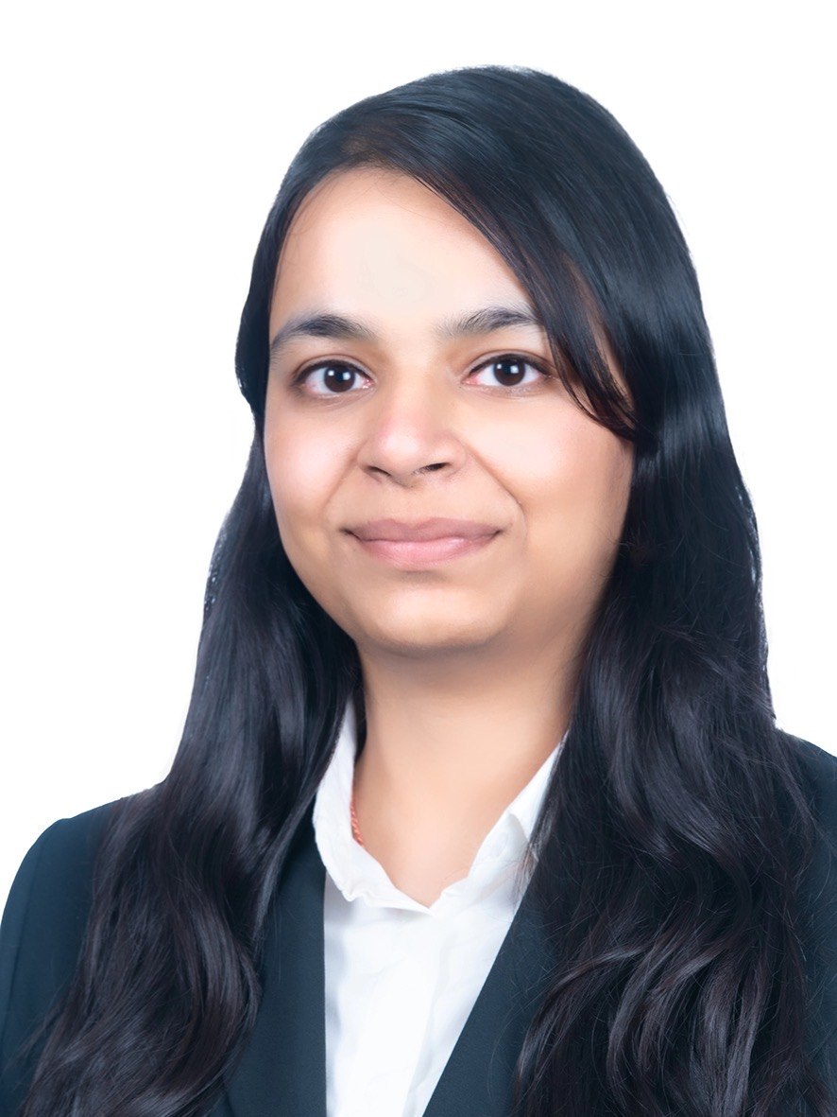

Case Problem Statement:
Promotional plan to boost trials and conversions for moisturizers at the peak of the upcoming winter season.
Team: The Strategists
Prakhar Jain
Ridhi Saraf
Shreyas Lakshminarayanan

Slide 2
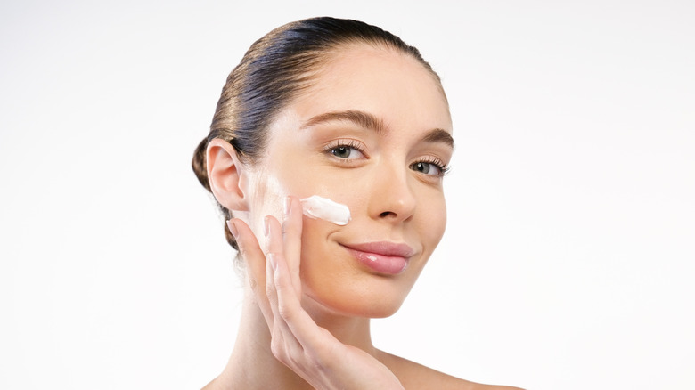





















3V’s standout as the gateway to most new consumers, reflected through their purchase patterns and ad spends: Voice, Video and Vernacular
Executive Summary
What is Cetaphil to me?
Action 1: Plain-packaging test
Action 2: Focus group results validation through reviews on ecommerce
Cetaphil v/s CeraVe
Super soft
All-time favourite for aging skin
Lasts longer
Great for sensitive skin
Dermatologist recommended
Gentle for sensitive skin
Soothes irritated skin well
Long lasting moisturizer
Small amount highly effective
CeraVe is oil-free, Cetaphil oily
Cetaphil feels sticky or heavy on skin
Caused water bumps
It smells like alkaline
Feels sticky on the face
Don’t know what product to use
Never heard of Cetaphil brand
Cetaphil smells slightly chemical
CeraVe leaves the skin feeling comfortable
Note: This test was performed on focus group of 4 randomly chosen college students
Platforms analysed
Building an ecosystem that can deliver the best of offline experience online: Brands that make it easy for consumers to find product content by building multiple content platforms are preferred.
Action points
…and how brands mitigate these situations
What target buyers are missing..
…and what should Cetaphil do?
Pro Tip
If every consumer is unique, like everyone else – Brands need to create content that engages and answers these unique needs.
Many skincare users are totally unaware of the Cetaphil brand
Make detailed product descriptions, pictures, videos available over internet
Enhancing digital presence and influencer partnerships
Consumers are uncertain about the right skincare product for them
Deploy online tools to help ensure user finds and gets right product easily
Promote Product Finder to let people know their skin type and personal routine care
Consumers seek immediate help for their skincare-related queries
Connect with consumer and interact with them frequently, making them loyal
Create ‘CetaCare’ – a WhatsApp support channel to provide personalised consultancy to consumers and build trust
Many consumers trust brands only when endorsed by their ideal celebrities
Linking product with people’s chosen personality to change their brand perception.
Partner with Rashmi Shetty, a celebrity dermatologist, to promote Cetaphil as derma-focused and chemical free product
Source: Uniquely India Digital Opportunity, Kalaari Capital | Euromonitor estimates on Beauty and Personal Care | Google Trend Analysis | Fortune Business Insights on Moisturizer Market | Expert interviews & CPG company annual reports

Slide 3










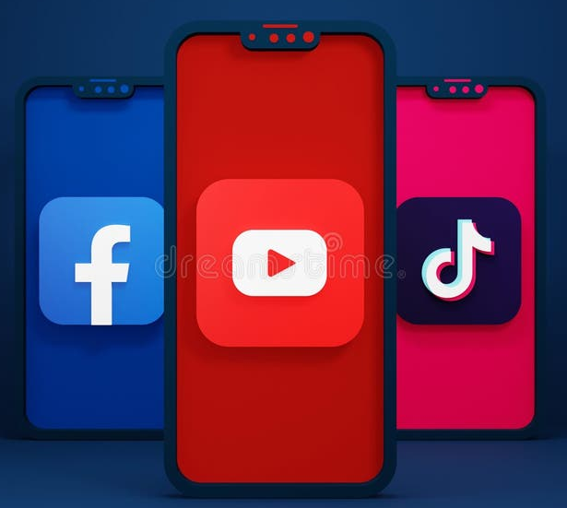






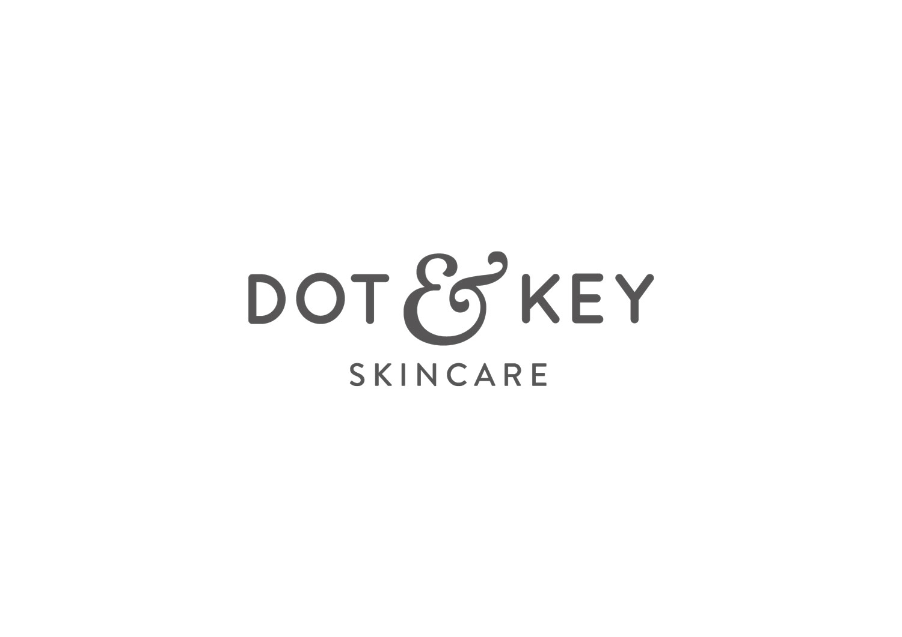
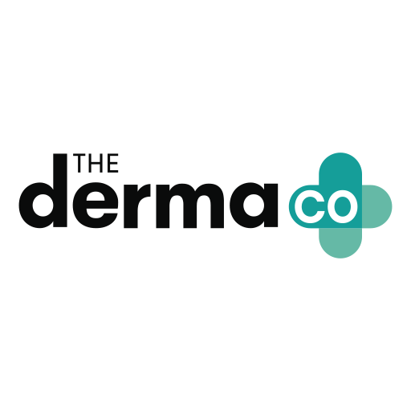
Target Shreya through influencer-driven, budget-friendly, non-greasy, and acne-free skincare, leveraging YouTube and Instagram validation
Meet Shreya
Shreya Sharma
22, PES University
“I love skincare because it helps me feel confident and keeps my sensitive skin healthy and radiant, especially during the winter.“
Purchasing Habits
Skincare Needs
Follows influencer skincare advice
Prefers online shopping for convenience and variety
Acne-Free solution for sensitive-skin
Solution for rapidly changing weather
Research-driven before purchase
Enjoys sharing validation posts after buying
Prefers non-sticky & non-greasy products
Open to experimenting with different brands
Trusts TikTok and YouTube reviews for product validation
Budget-conscious but seeks effective skincare solutions
Prefers products with higher content of Vitamin-E & Vitamin-C
Concerned about the ingredients & prefers lighter products
“With the upcoming winters, I need a brand which will provide the best moisturization for my sensitive skin at the best possible price while being the safest possible option"
Go-To
Brands

Slide 4
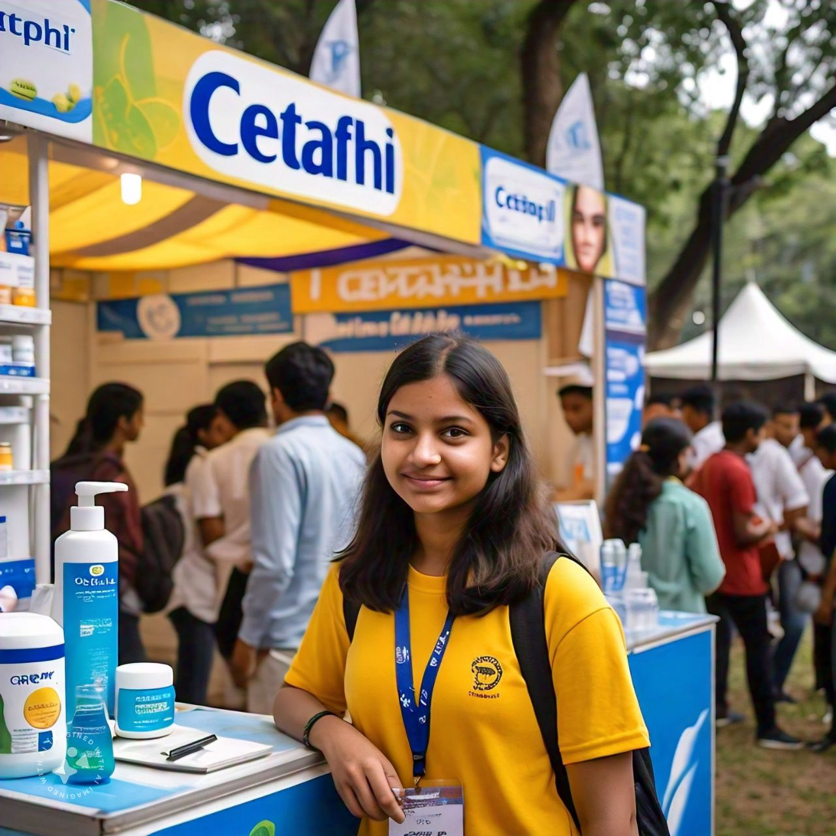
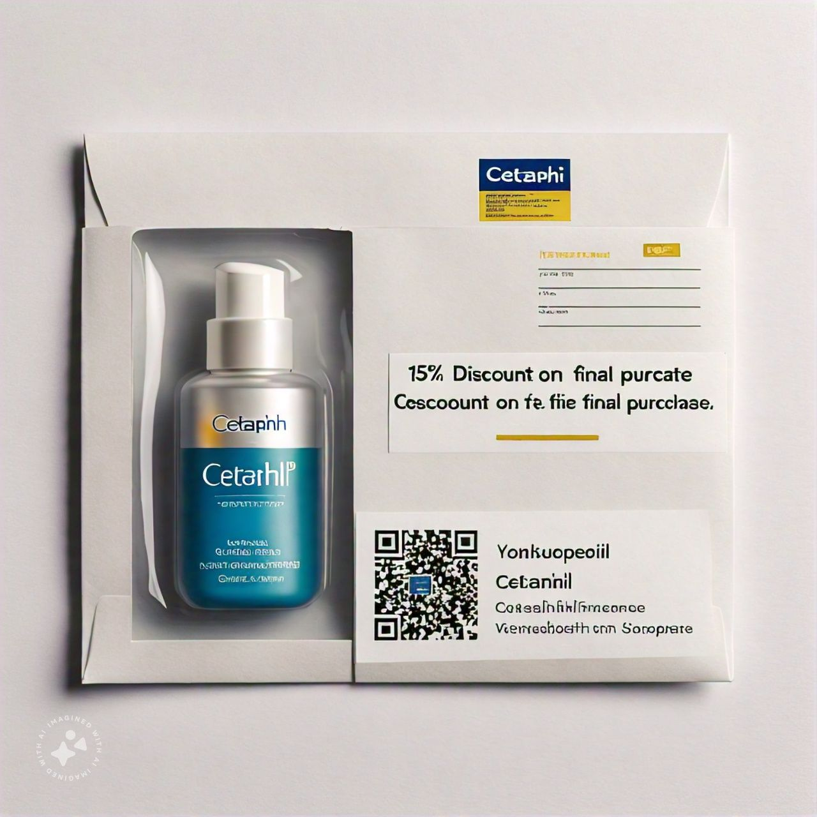
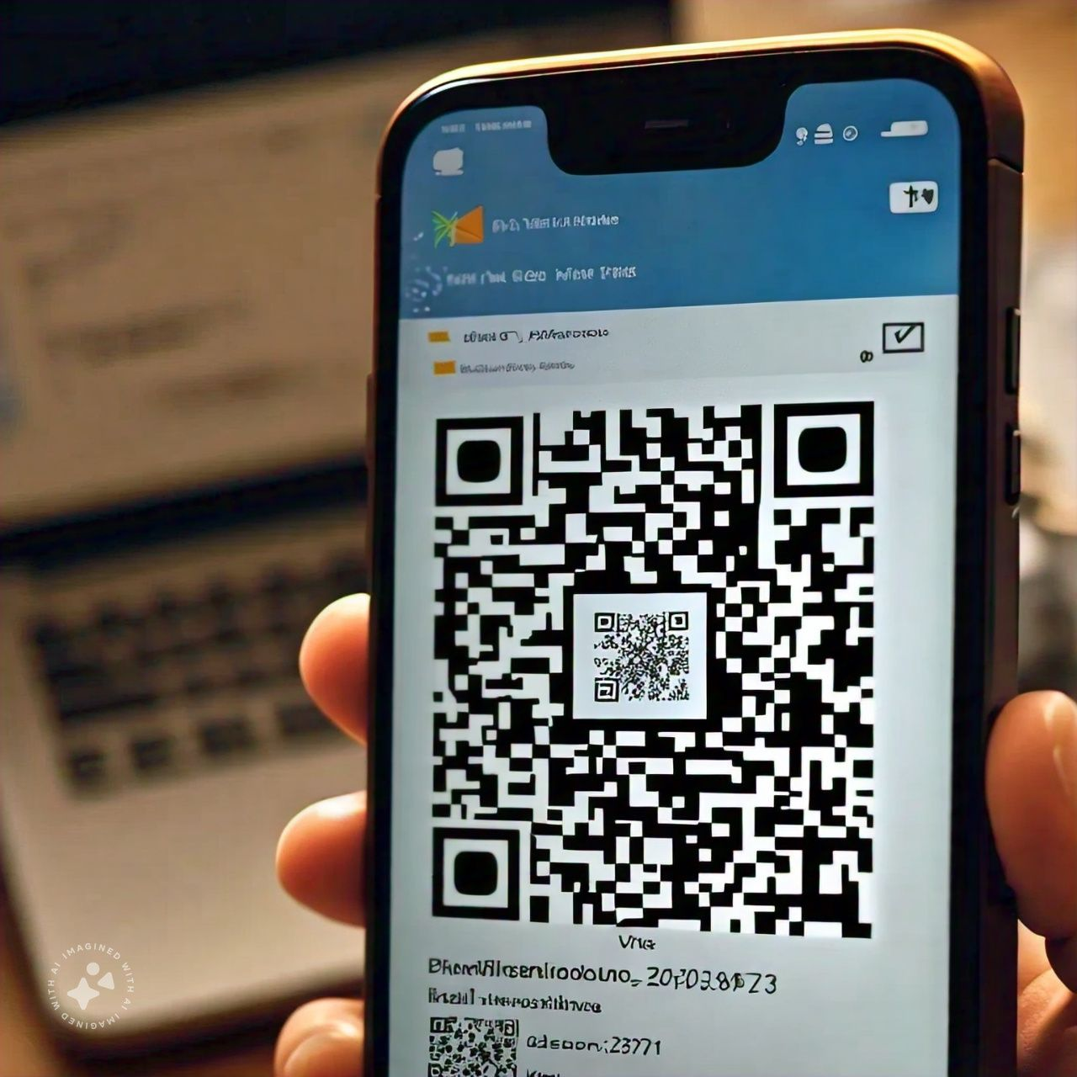
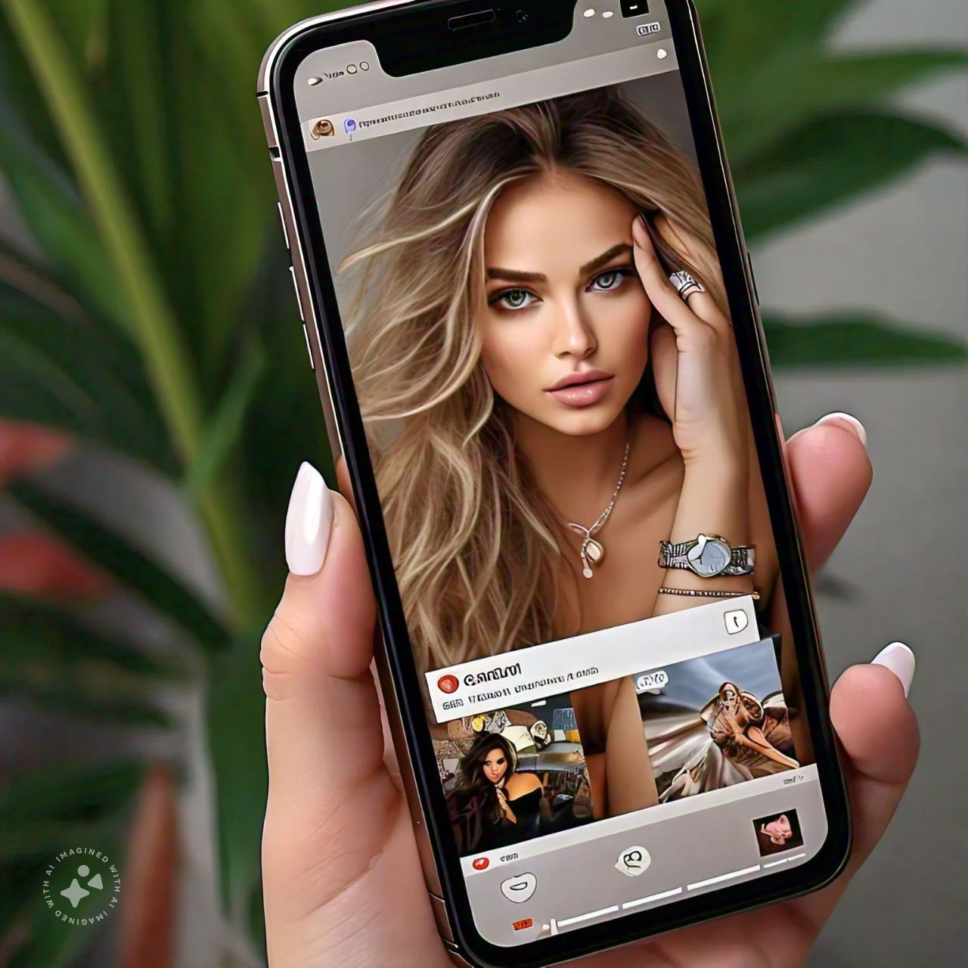
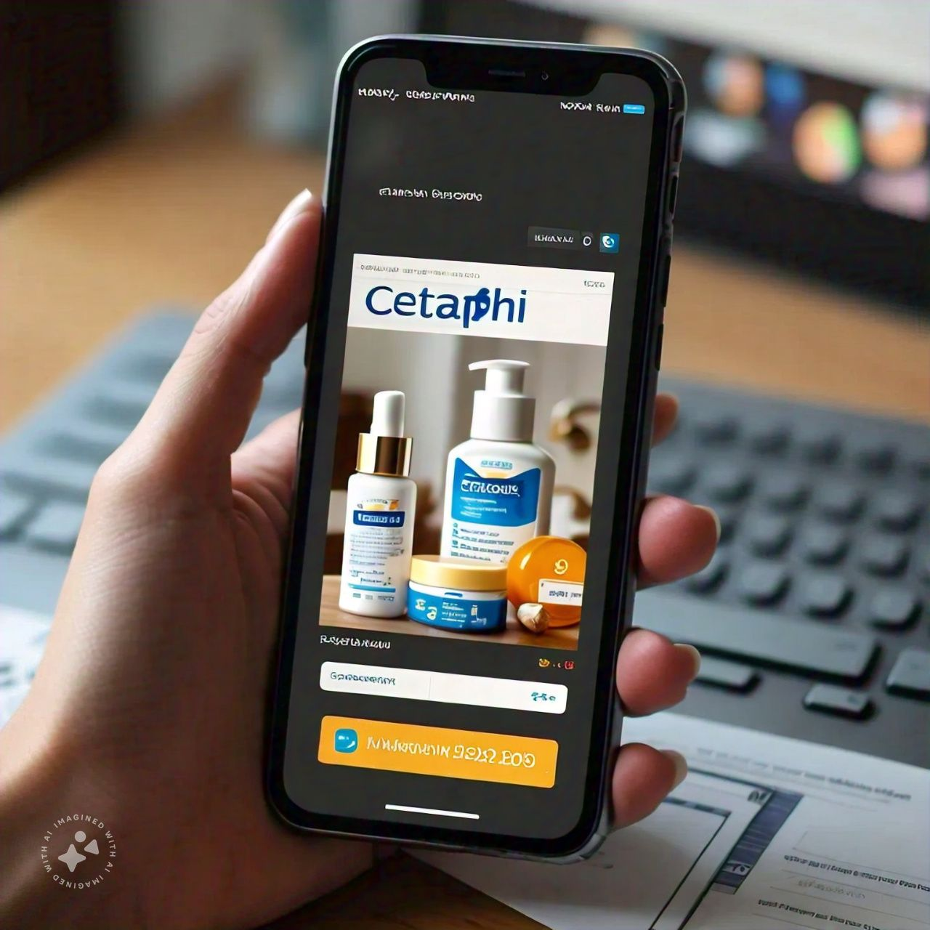
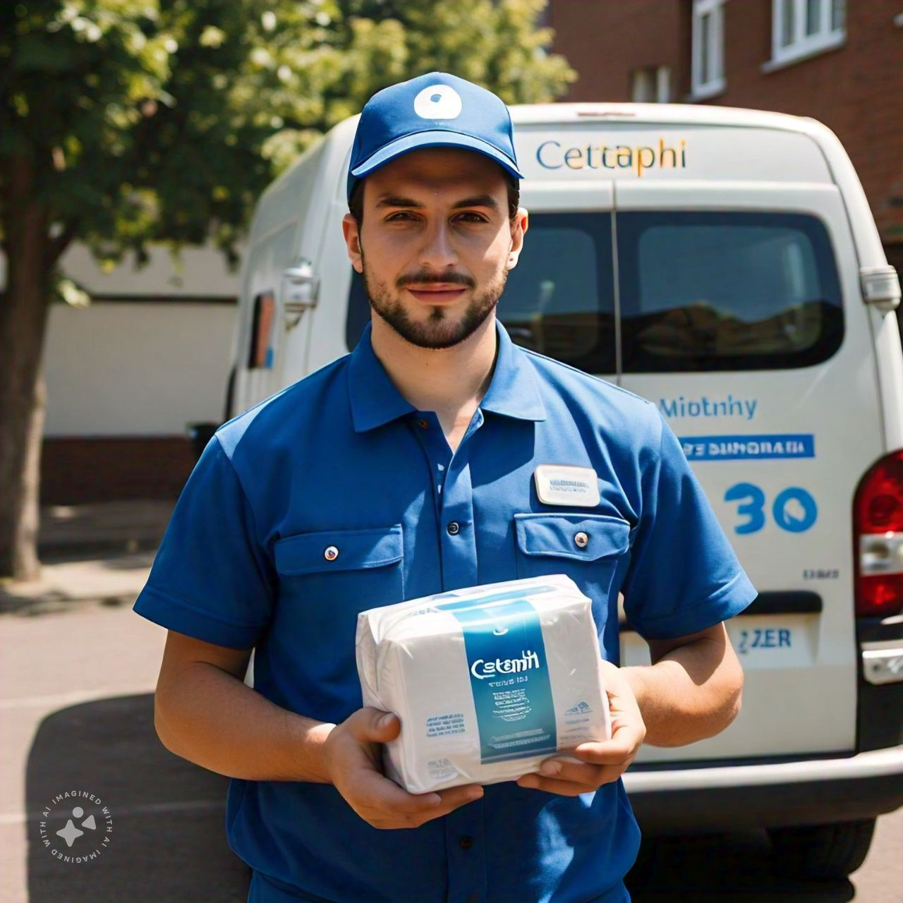
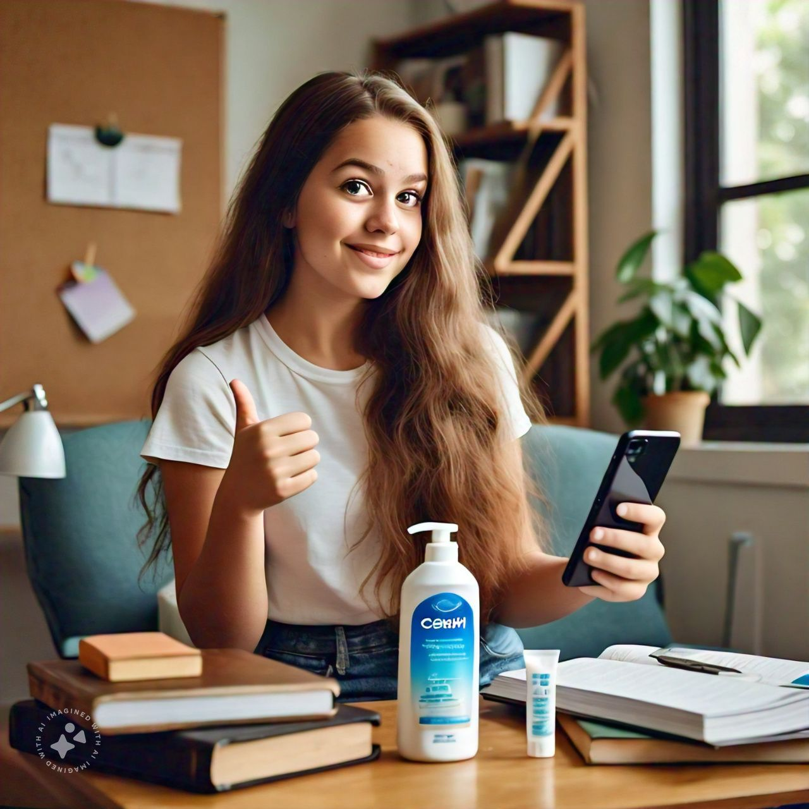
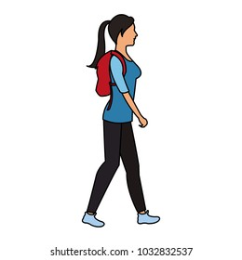


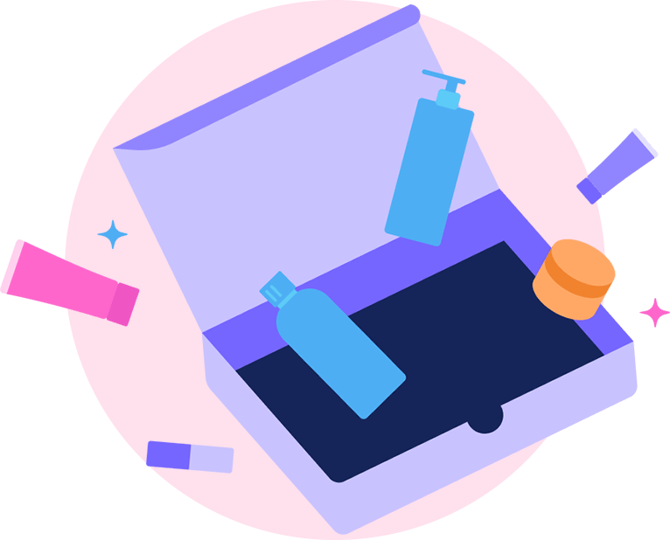
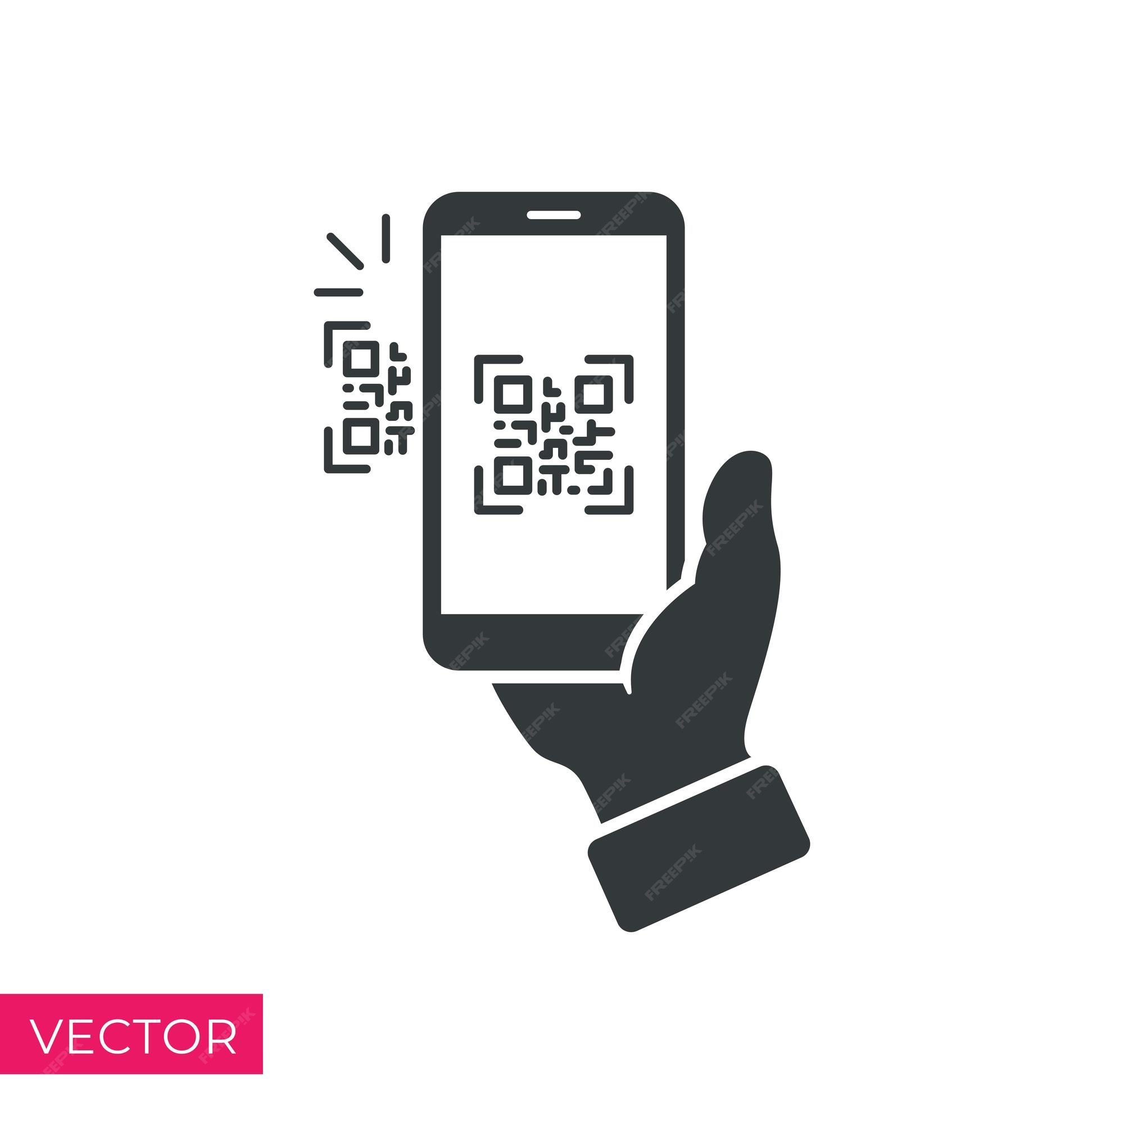









Engage Shreya with Cetaphil kiosks, QR code trials, celebrity validation, and reliable post-purchase experiences for loyalty
Shreya at the college
Awareness
Engagement
Research
Validation
Conversion
Retention
Advocacy
Cetaphil
kiosk
Free sample
+ QR code
Product Finder via QR Code
Celeb validation
Website Purchase
Quick
delivery
Social
media
amplification
Shreya, worried about dry winter skin, discovers a Cetaphil kiosk at her college.
Shreya receives a trial card with a QR code and 15% discount code.
She scans the QR code, accessing Cetaphil’s Product Finder for tailored recommendation.
Seeing influencer Kiara Advani and dermatologist Rashmi Shetty promoting Cetaphil boosts her confidence.
She orders a moisturizer and cleanser online using the 15% discount from the website,
Her order arrives in 2 days, enhancing her experience and she starts a consistent routine.
She tags Cetaphil on Instagram, showcasing her glowing skin, and earns a referral bonus by recommending it to friends.
Objectives for Cetaphil
Introduction to Cetaphil
Engage with incentives
Personalize recommendations
Build trust through influencers
Convert to a paying customer
Quick and reliable delivery
Foster advocacy & loyalty

Slide 5

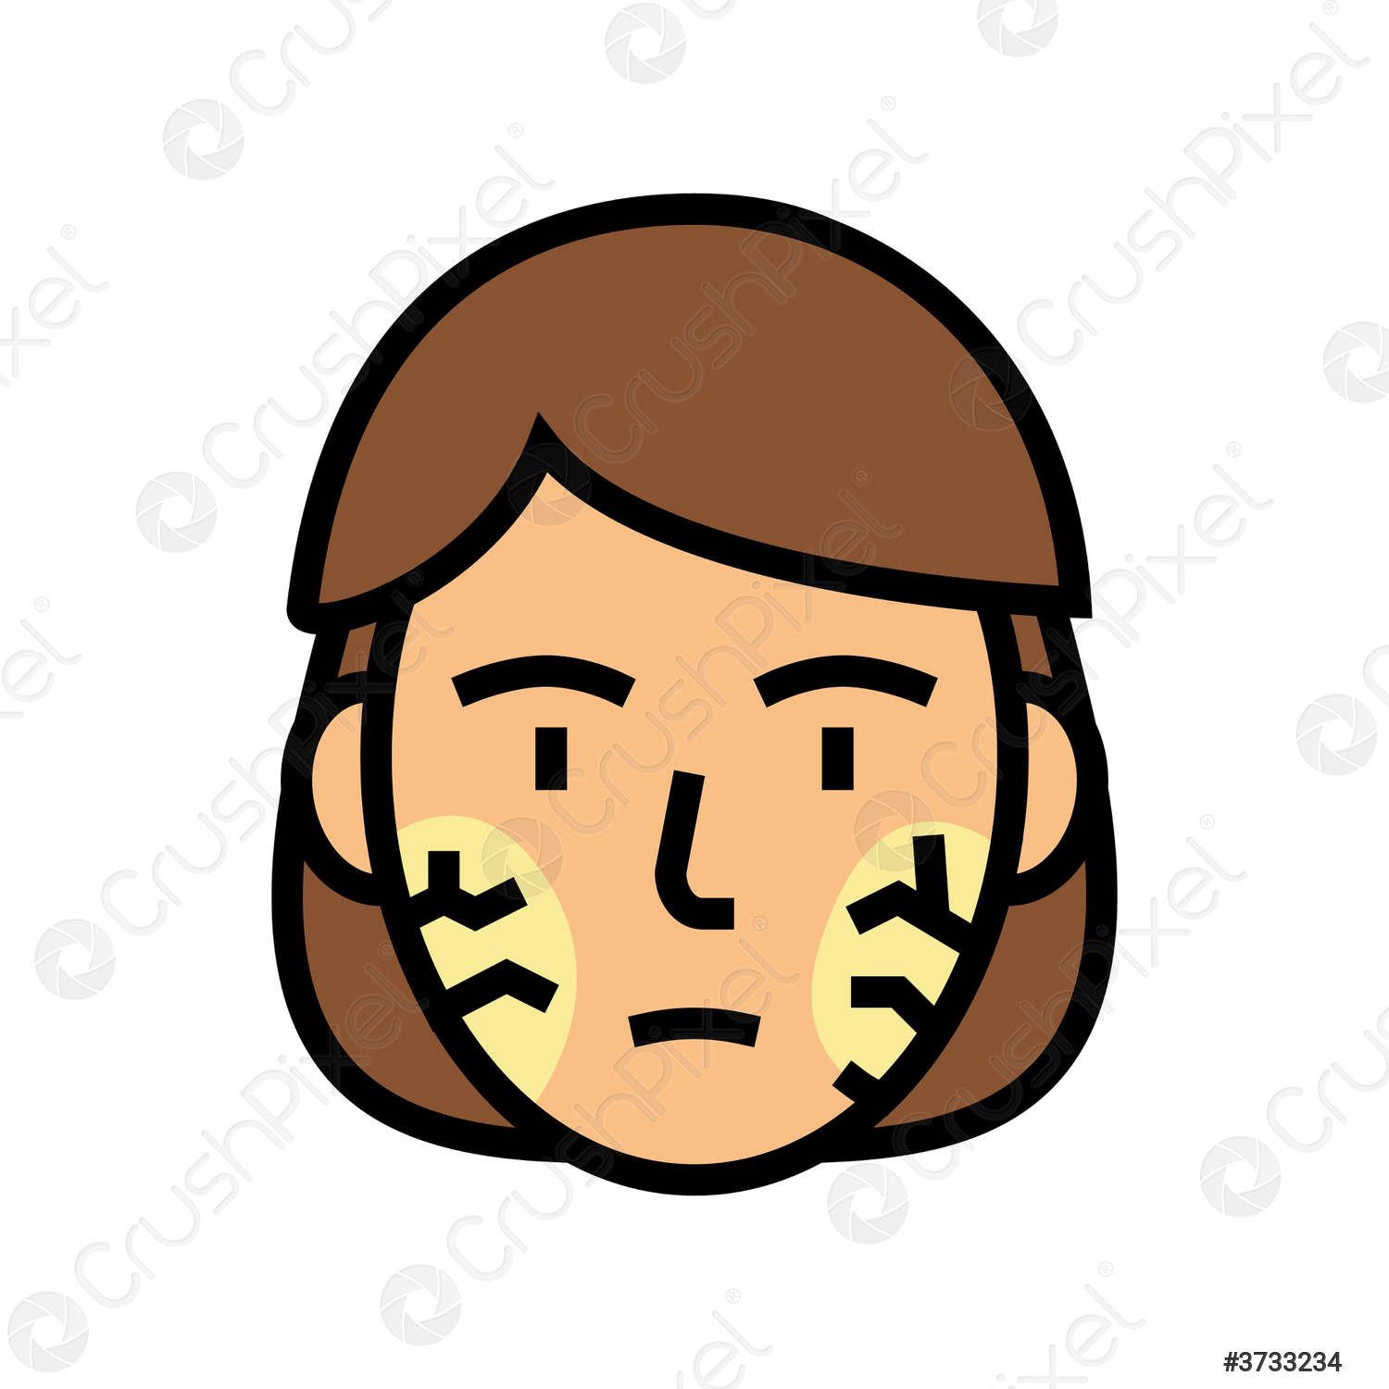

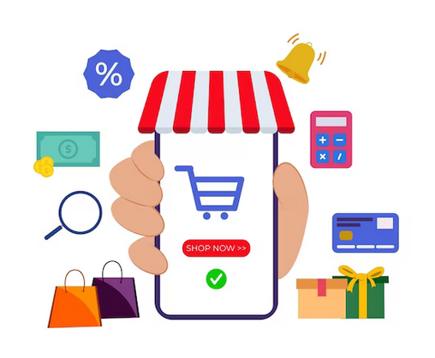


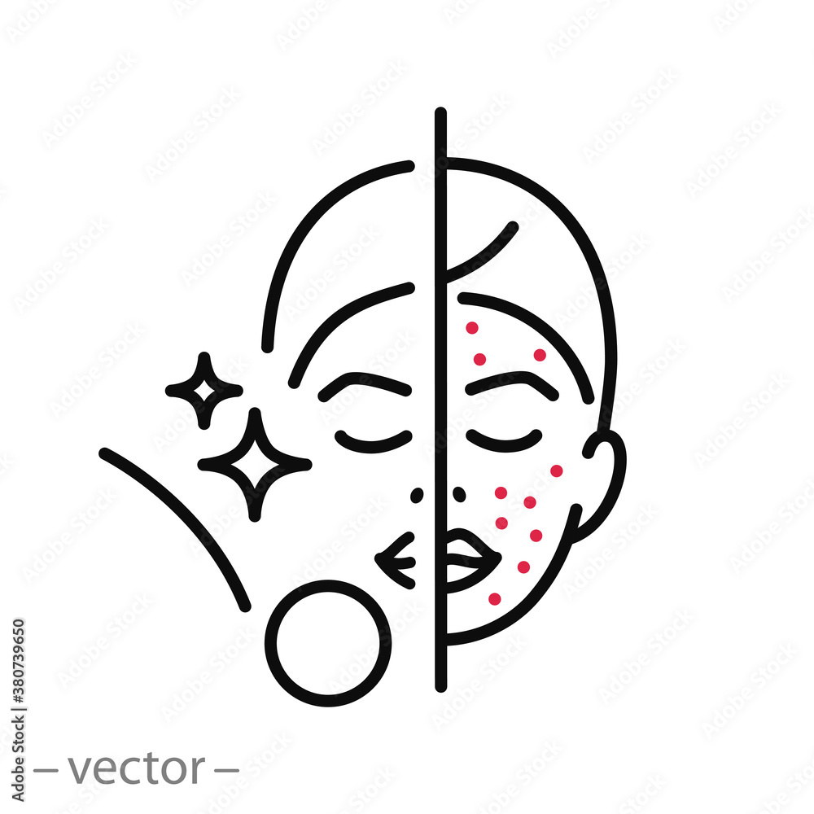
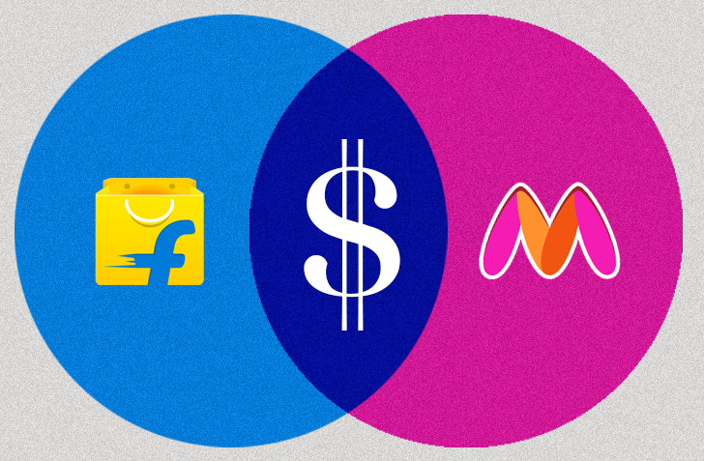







Anjana is a busy professional seeking no-fuss skincare solutions that fit her demanding lifestyle, focusing on convenience, instant results, and brand reliability
Meet Anjana
Anjana Desai
32, JPMC
“I love skincare because it gives me quick, reliable solutions for my busy lifestyle, keeping my skin hydrated and stress-free all day.“
Purchasing Habits
Skincare Needs
Chooses online shopping for convenience and variety over physical store visits
Impulse buyer with limited time, rarely conducts in-depth product research
Quick-fix to reduce dryness from AC exposure
Solution for counteracting stress-induced acne
Long-lasting hydration to tackle the entire workday
Solution for Pollution-causing dryness
Prefers purchasing from regular marketplaces like Nykaa, Myntra, Amazon, Zepto, etc.
No focus on discounts, prioritizes instant delivery for immediate needs
Prefers multi-sized and travel-friendly packages
Prefers to choose single brand over experimenting
“I need a no-nonsense brand that I can trust comfortably to fulfil my skincare needs while making sure I don’t waste time searching and ordering every time I run out of a moisturizer”
Go-To
Brands

Slide 6
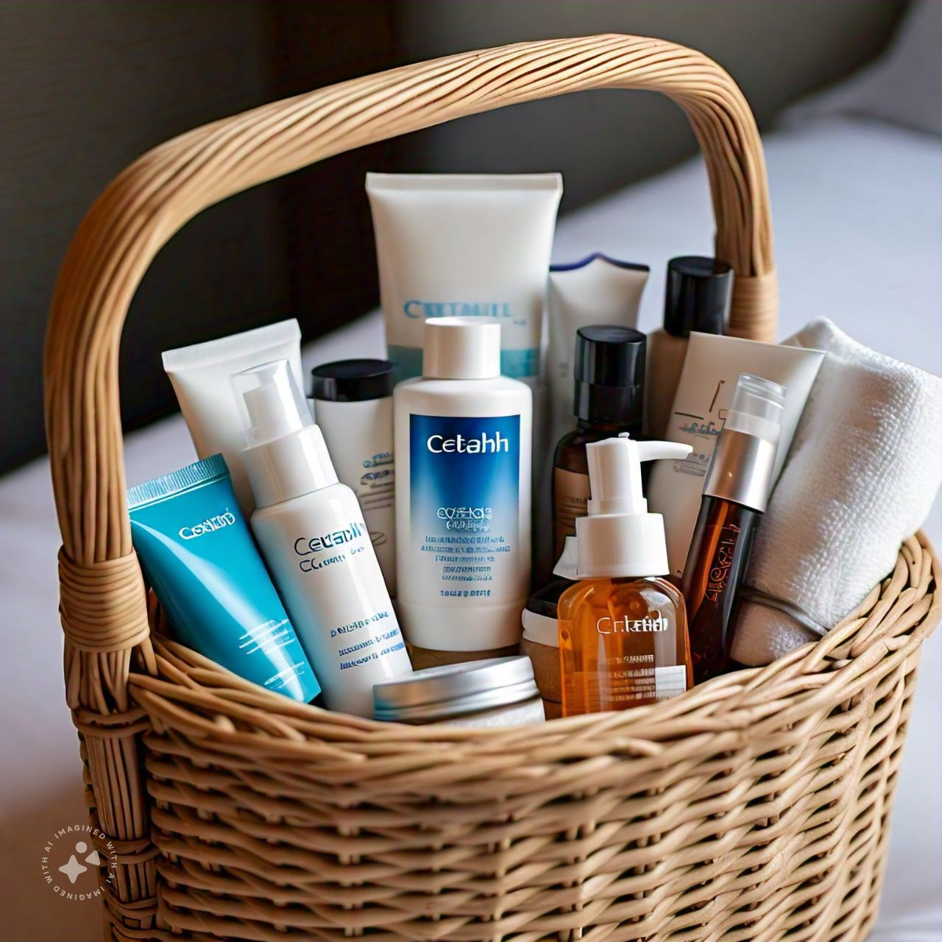
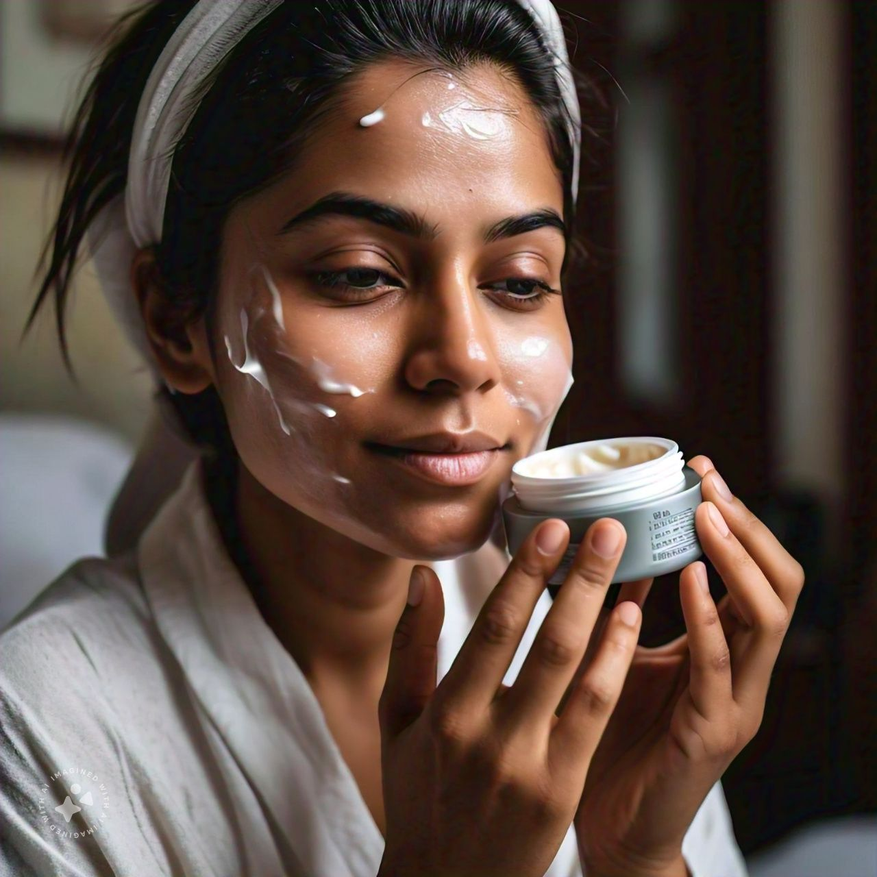
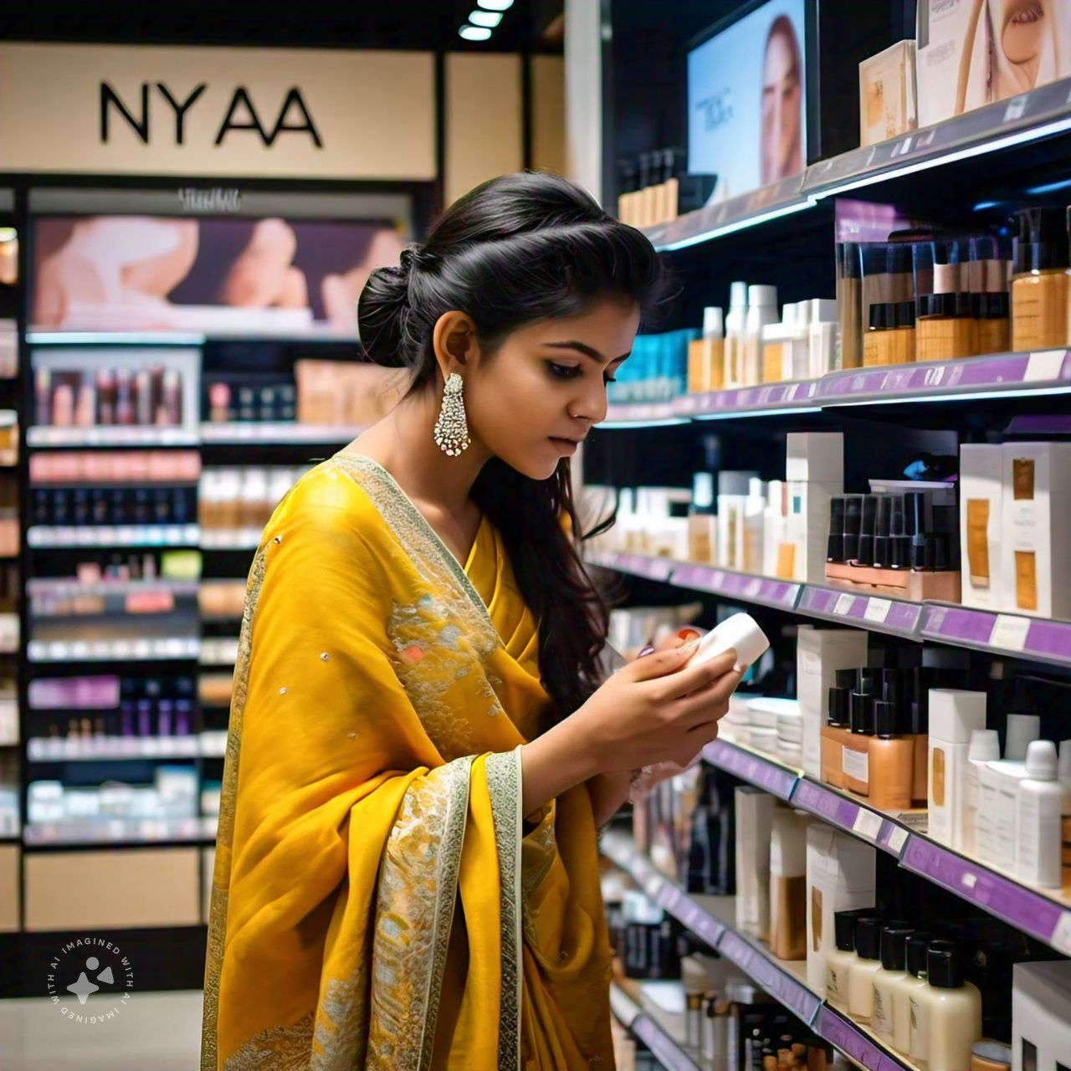
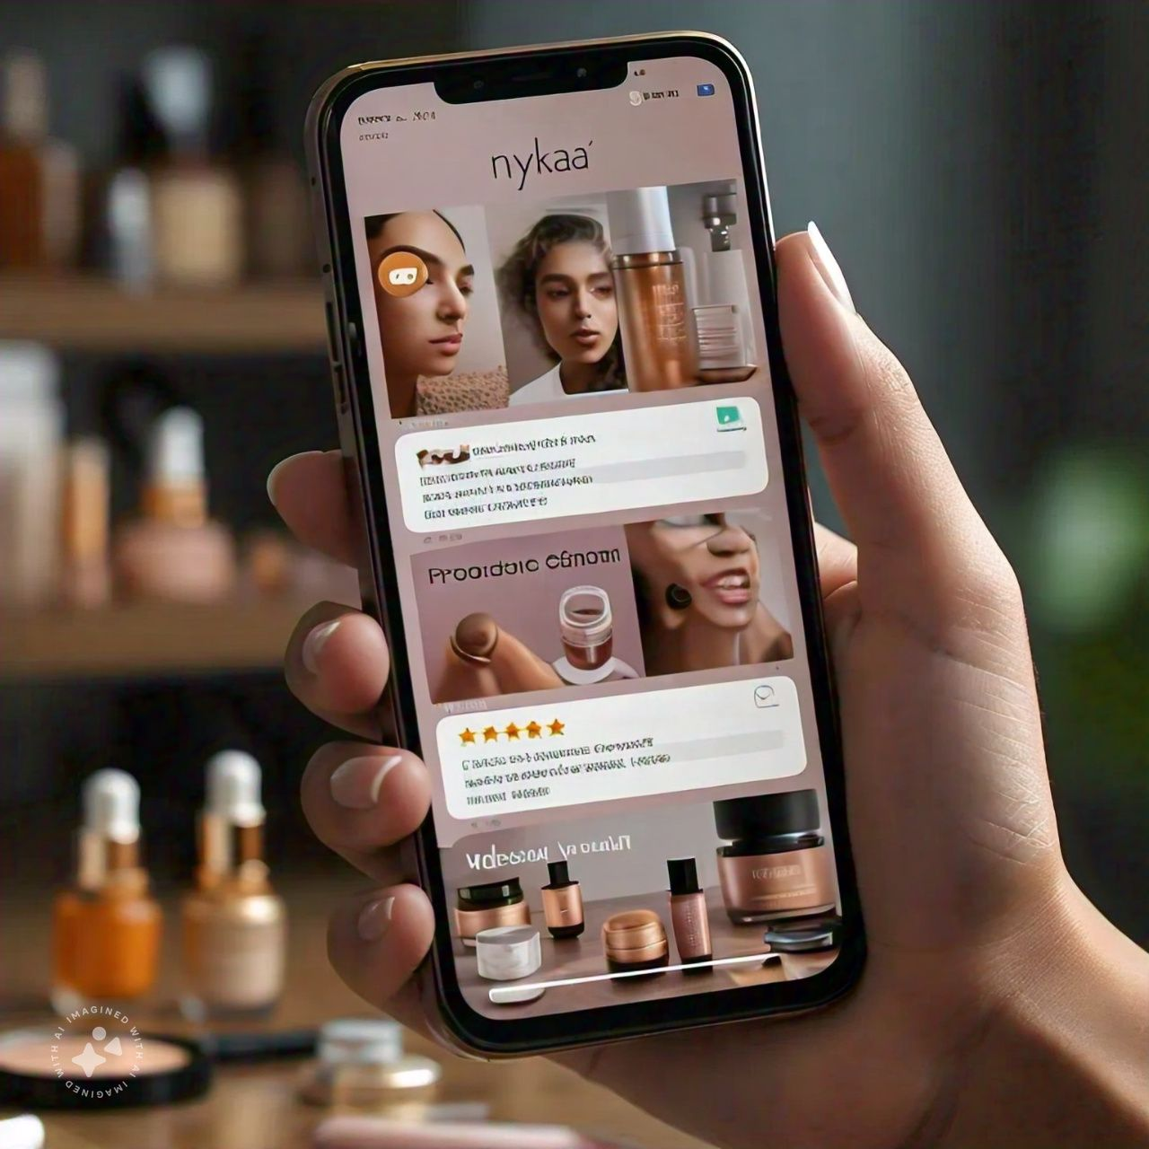
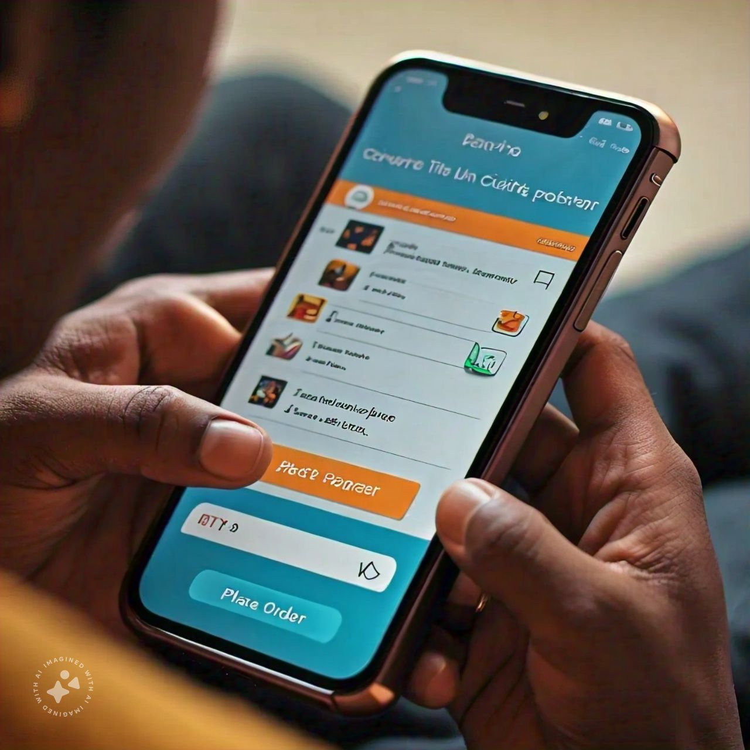
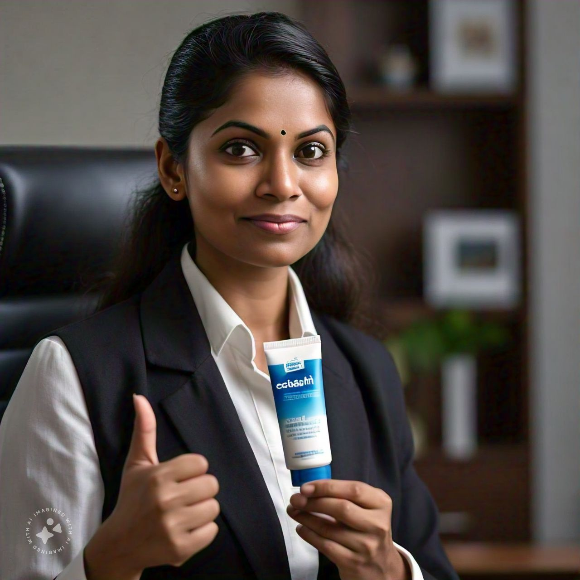
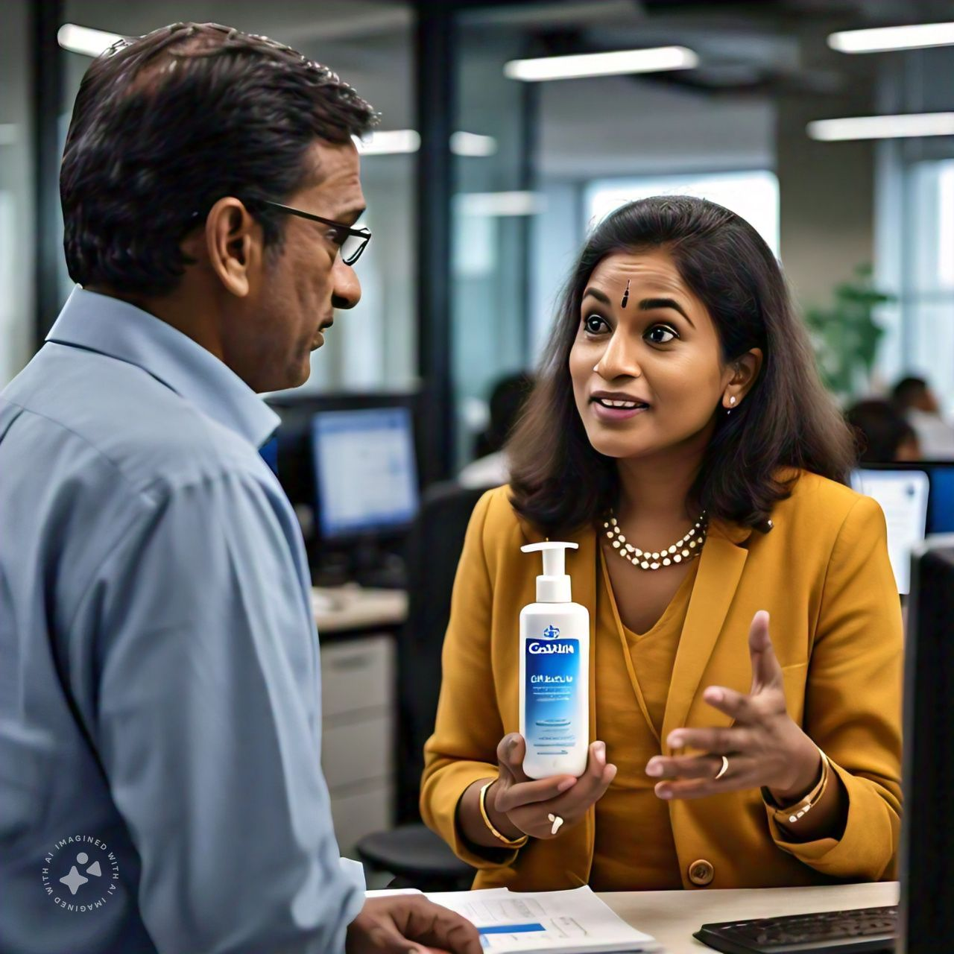
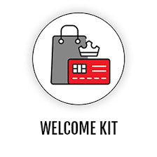


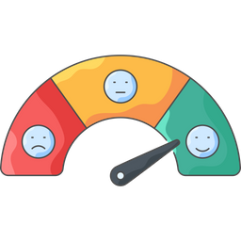


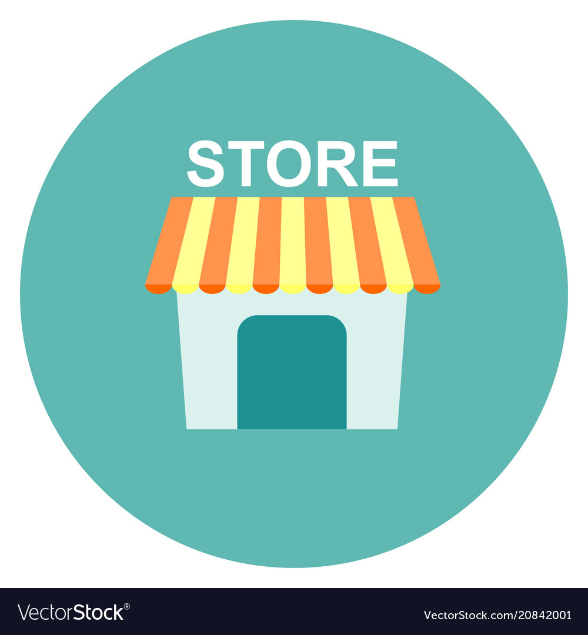



Journey from trial to advocacy - initiating with free samples and moving towards reviews and Q comm - how Cetaphil fosters customer loyalty through experiential marketing and convenience
Anjana during her offsite visit
Awareness
Engagement
Research
Validation
Conversion
Retention
Advocacy
Samples at Hotel
First time use
Discovery on Nykaa
Review research on Nykaa
Zepto collaboration
Subscription for future usage
Word of mouth promotion
During her December office trip, Anjana receives a Cetaphil moisturizer sample at Ibis Hotel.
After using the sample, Anjana enjoys smooth, hydrated skin all day.
She explores a variety of Cetaphil moisturizers on Nykaa app, finding one tailored to her skin type.
Anjana reads dermatologist-backed reviews on the Nykaa app, reinforcing her trust in Cetaphil.
Confident in the brand, she orders Cetaphil products via Zepto for quick delivery.
Impressed by its long-lasting hydration, Anjana subscribes to Cetaphil for regular deliveries.
She recommends Cetaphil to her colleagues, creating organic brand promotion.
Objectives for Cetaphil
Introduction to Cetaphil
Create a positive first experience
Offer research via premium store presence
Build trust with ecommerce reviews
Convert to a paying customer
Drive retention with a subscription plan
Foster advocacy & loyalty

Slide 7


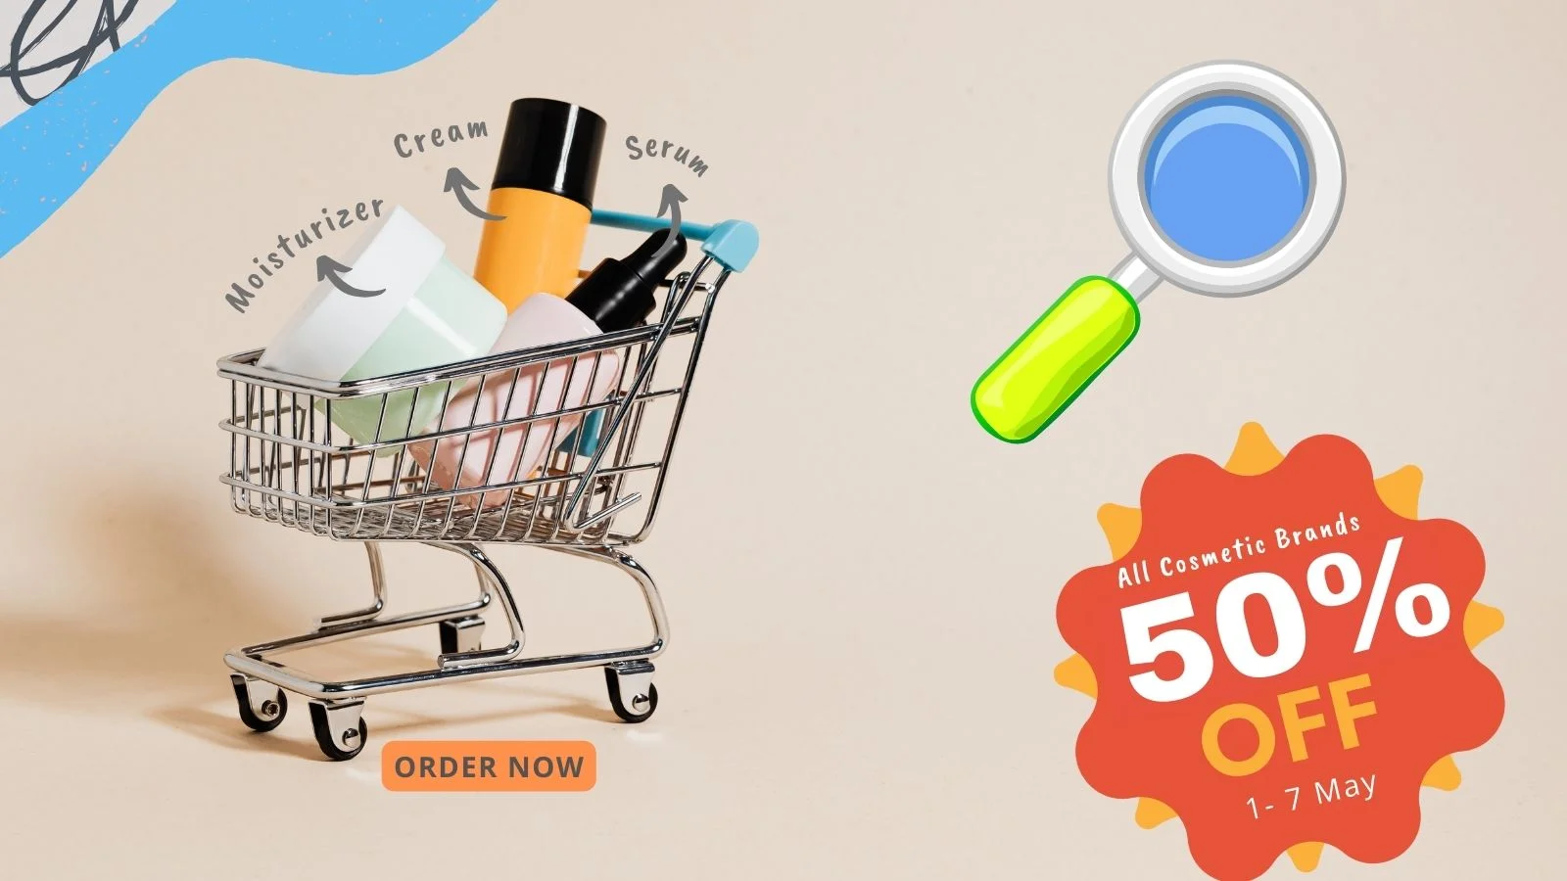
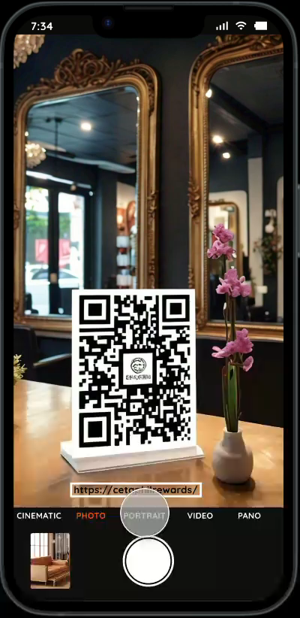
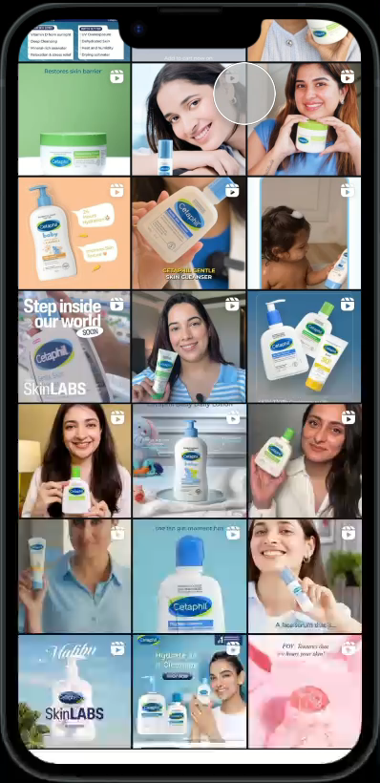
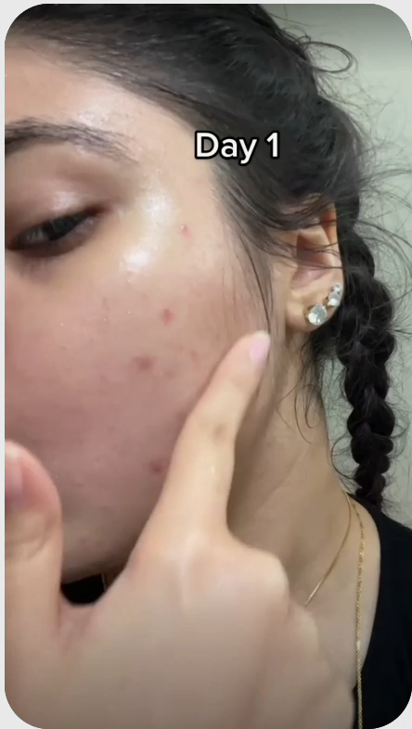
AR gamification and interactive digital tools drives engagement, turning passive ads into interactive moments, encouraging trial and instant purchase decisions
Campaigns for buzz creation
RAISE AWARENESS
ENCOURAGE TRIAL
ENSURE PURCHASE
Cetaphil Cam - Giveaway & Discounts
Cetaphil Quiz – Know Your Skin Type
Social Proof
Cetaphil Cam QR codes will be available at salons/spas.
By scanning billboards or posters, users instantly unlock offers.
Call To Actions drive immediate purchase action.
Quiz Stickers offer an interactive way to engage with audience on Instagram Stories.
Track total votes and see individual responses – for understanding followers better!
Real results, motivating potential buyers via authentic transformations.
Notes:
`

Slide 8
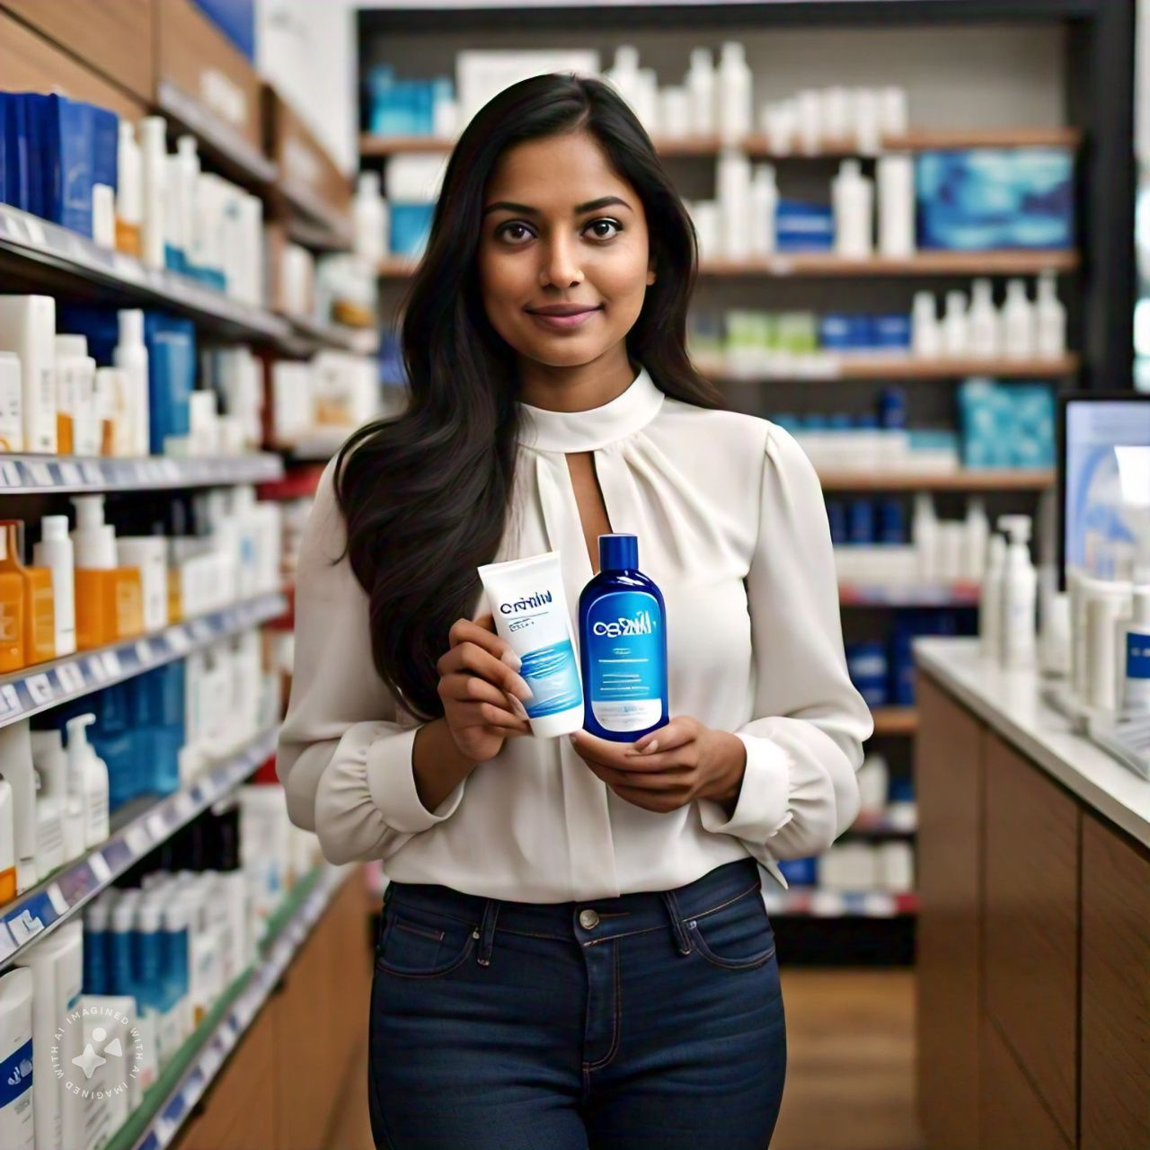
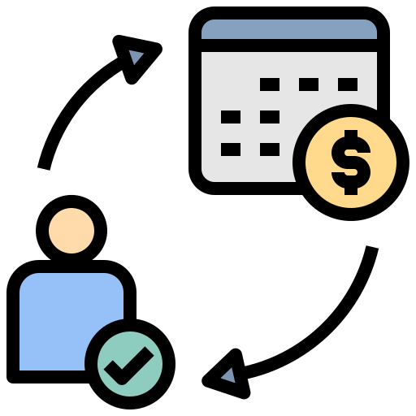


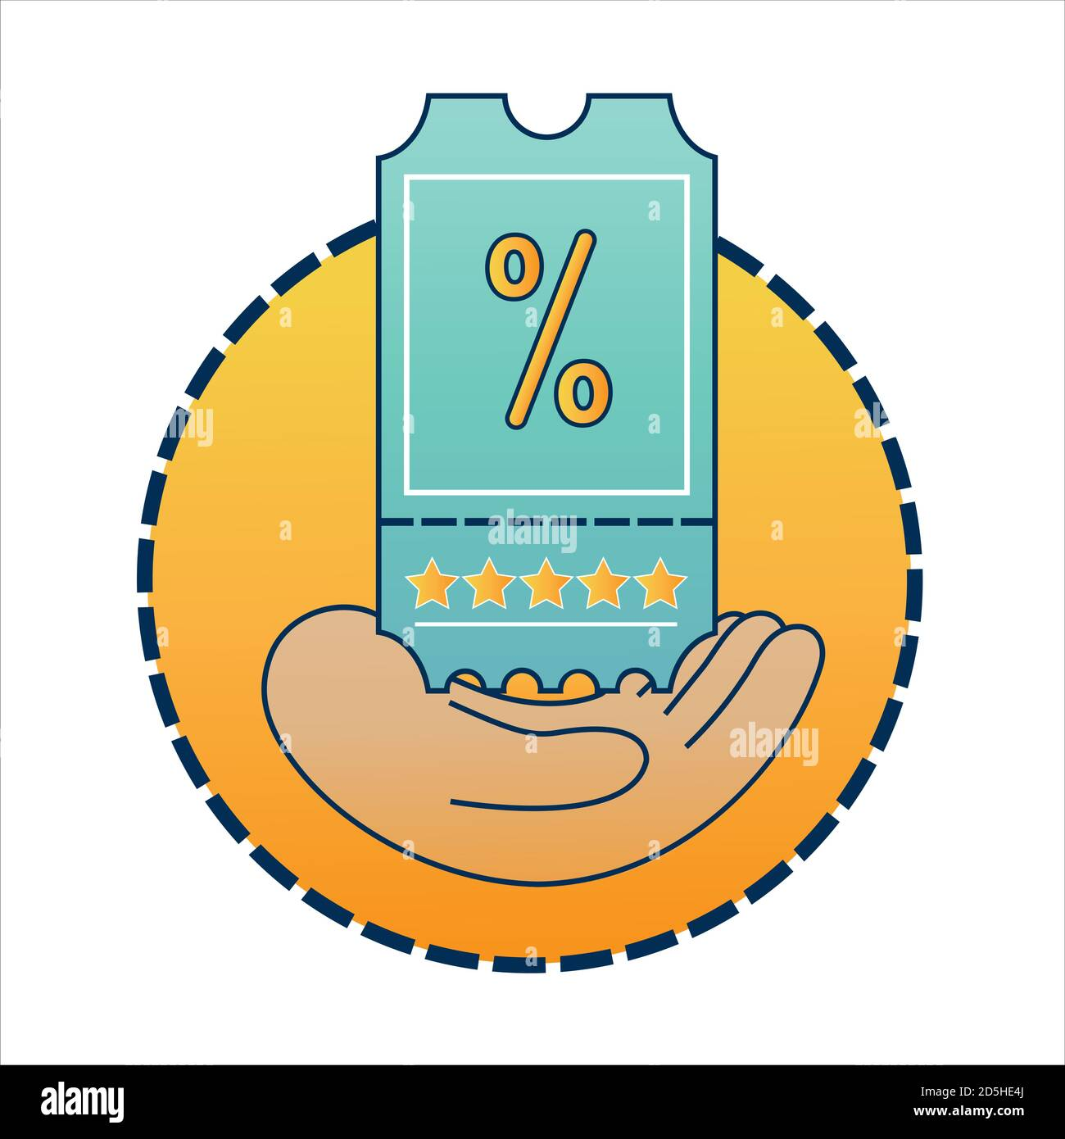

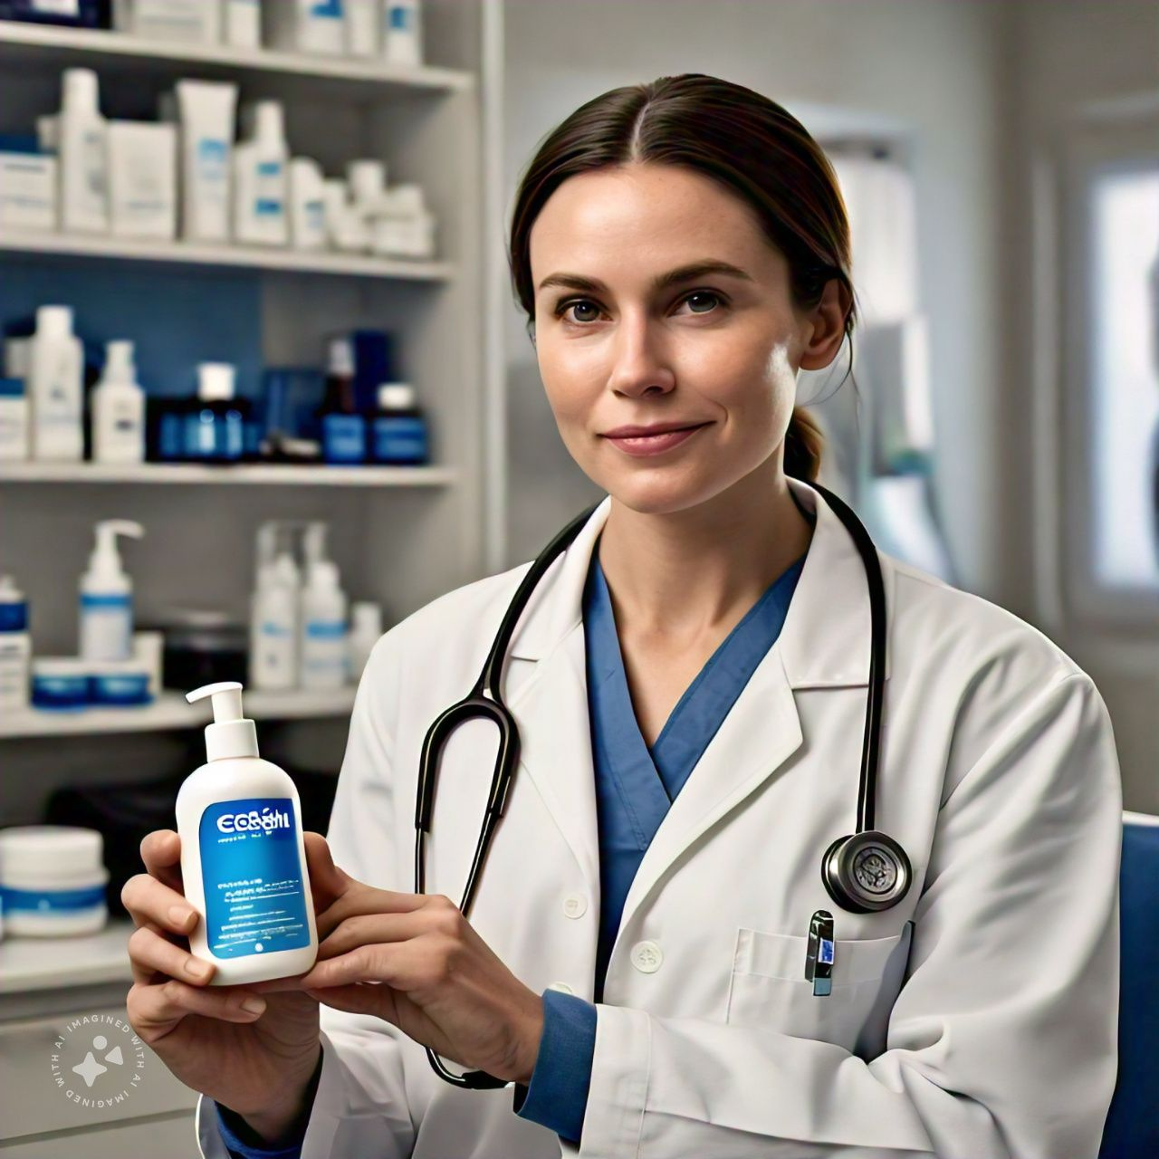





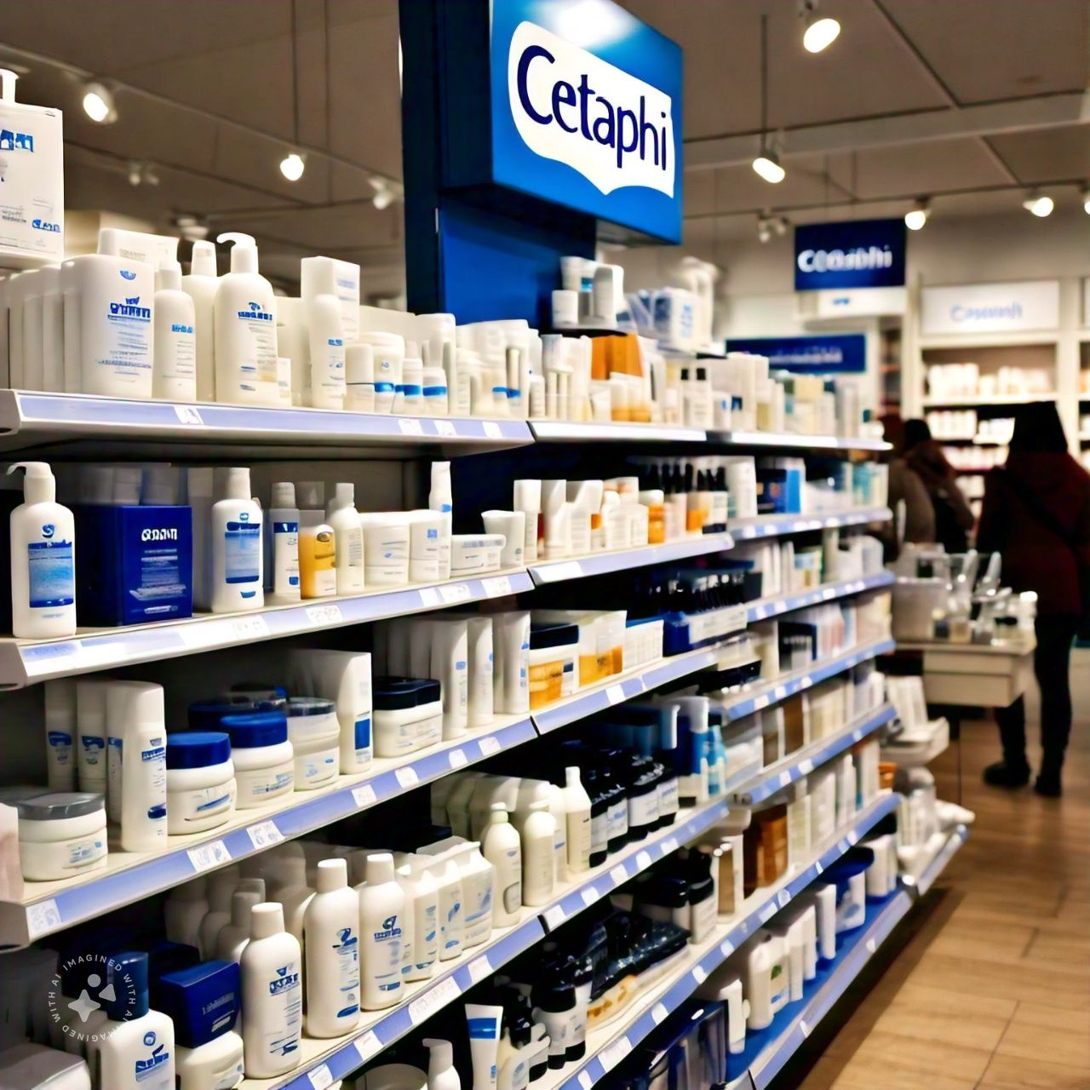


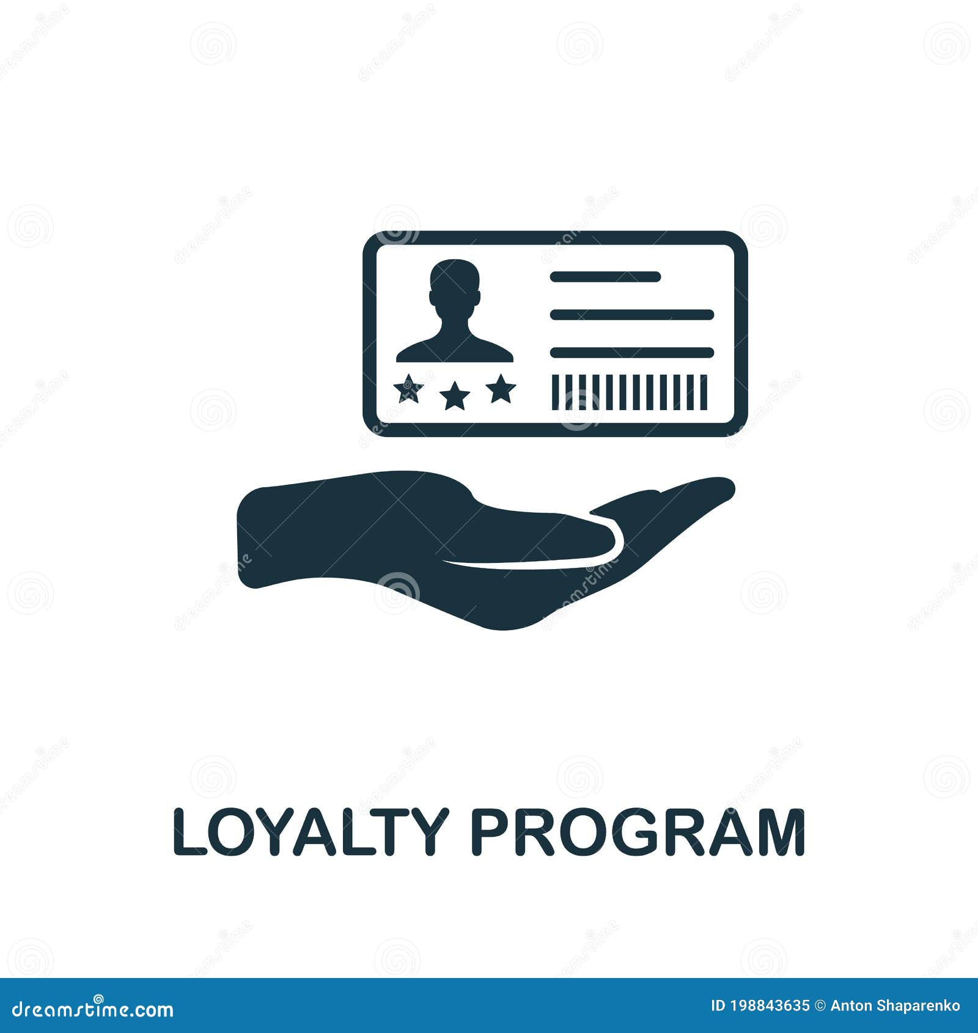








The strategy stipulates tailored benefits for stakeholders across board, enhancing Cetaphil’s brand loyalty, credibility, and growth
What’s in it for the stakeholders
Customers | Subscription benefits | Personalized skincare app | Personalized consultations | Loyalty benefits | 24/7 virtual skin advisor
Dermatologists | Collaboration on Research & Innovation | Continuing education sponsorship | Professional sampling program | Co-Branding Opportunities | Enhances professional credibility
Retailers | Exclusive in-store promotions & discounts | Higher AOV and more cross-sell opportunities | Cetaphil’s program tied with retailer's schemes | QR Codes & Interactive Product Displays | Retailers benefit from Cetaphil’s marketing
Organization | Scientific credibility boost | Increased brand advocacy | Improved shelf presence | Increased shareholder confidence | Higher company valuation

Slide 9







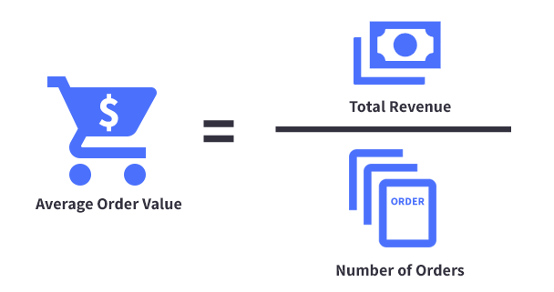
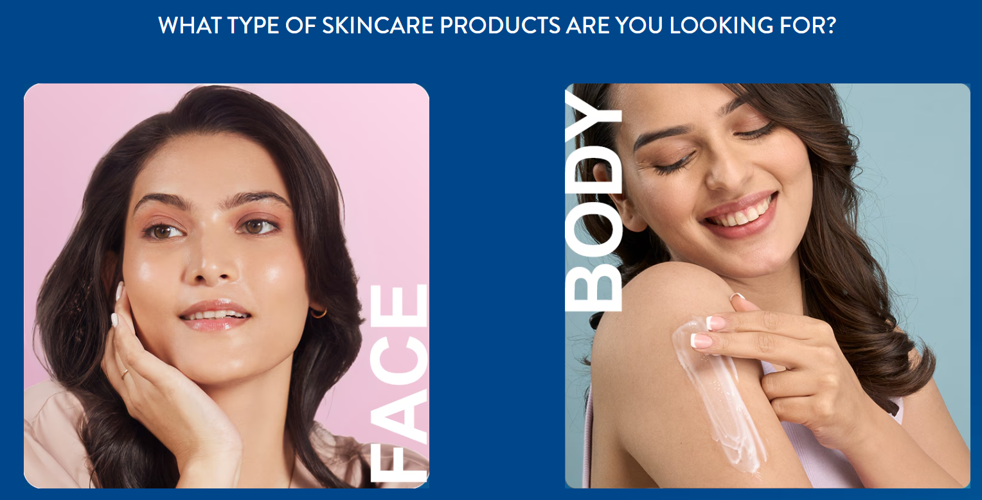







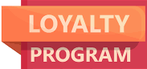
Expand Cetaphil's daily reach through key retail partnerships, influencer engagement, and user-driven loyalty strategies ensuring continuous engagement with both current and potential user
Consumers at the core
Where to Play
How to Win: 3C and P-O-E-M
Accelerate Cetaphil’s reach by positioning it as a go-to derma-cosmetic solution for everyday skincare.
Connect
Continuously Engage
Convert
Media:
Paid | Influencer partnerships | Targeted social media ads | Special offer ads
Owned | Loyalty program | Social media profile | Social proof
Earned | UGC on social media | Hashtag & community building | Word-of-mouth
Metrics
NORTH STAR
CONVERSION RATE
L0 METRICS
CLTV SALES CAC
L1 METRICS
PPV ATC BNC
ACTIVATION
ENGAGEMENT
RETENTION
New Users
Samples Distributed
Trial Pack Purchases
Repeat Purchases
Average Order Value
Product Finder Usage
Customer Retention Rate
Net Promoter Score
Subscription Sign-ups
Website Sign-ups
Bounce Rate
Session Length
User-generated Content
Repurchase Frequency
Loyalty Program Participation

Slide 10




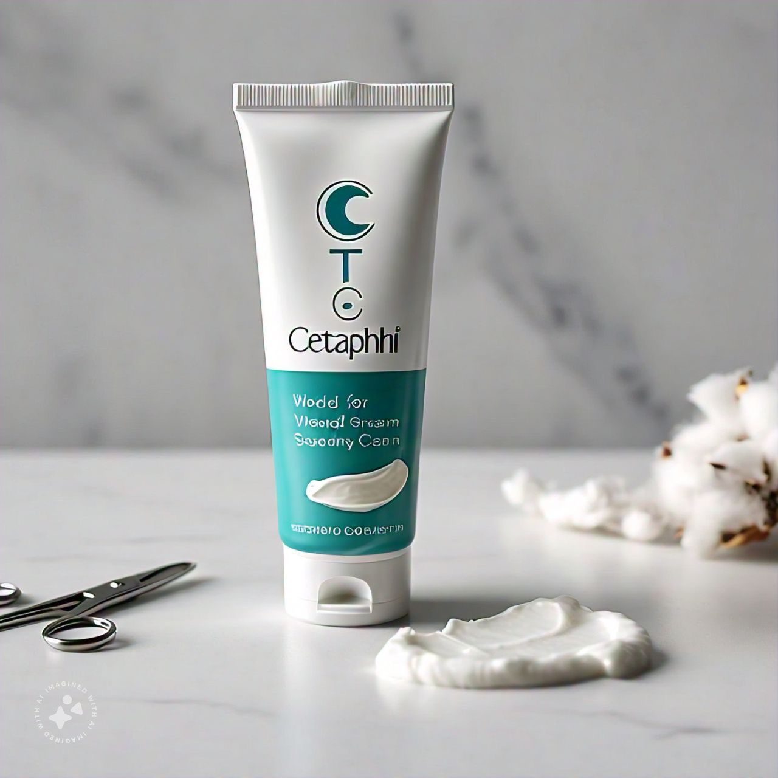

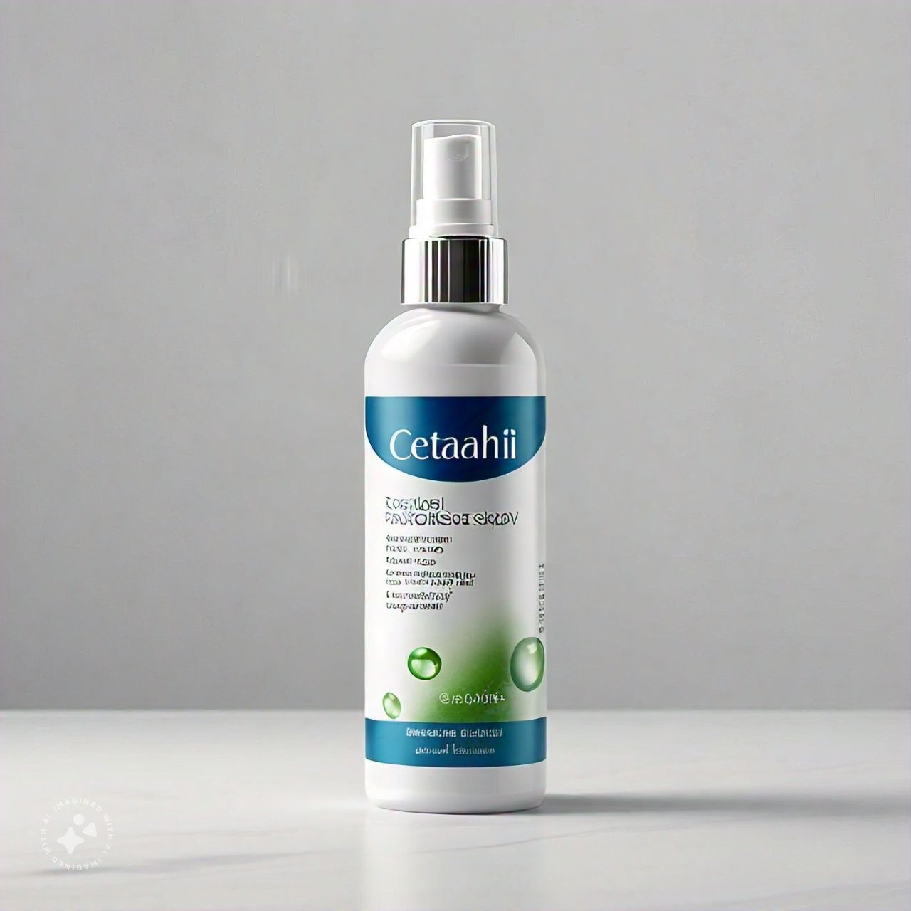

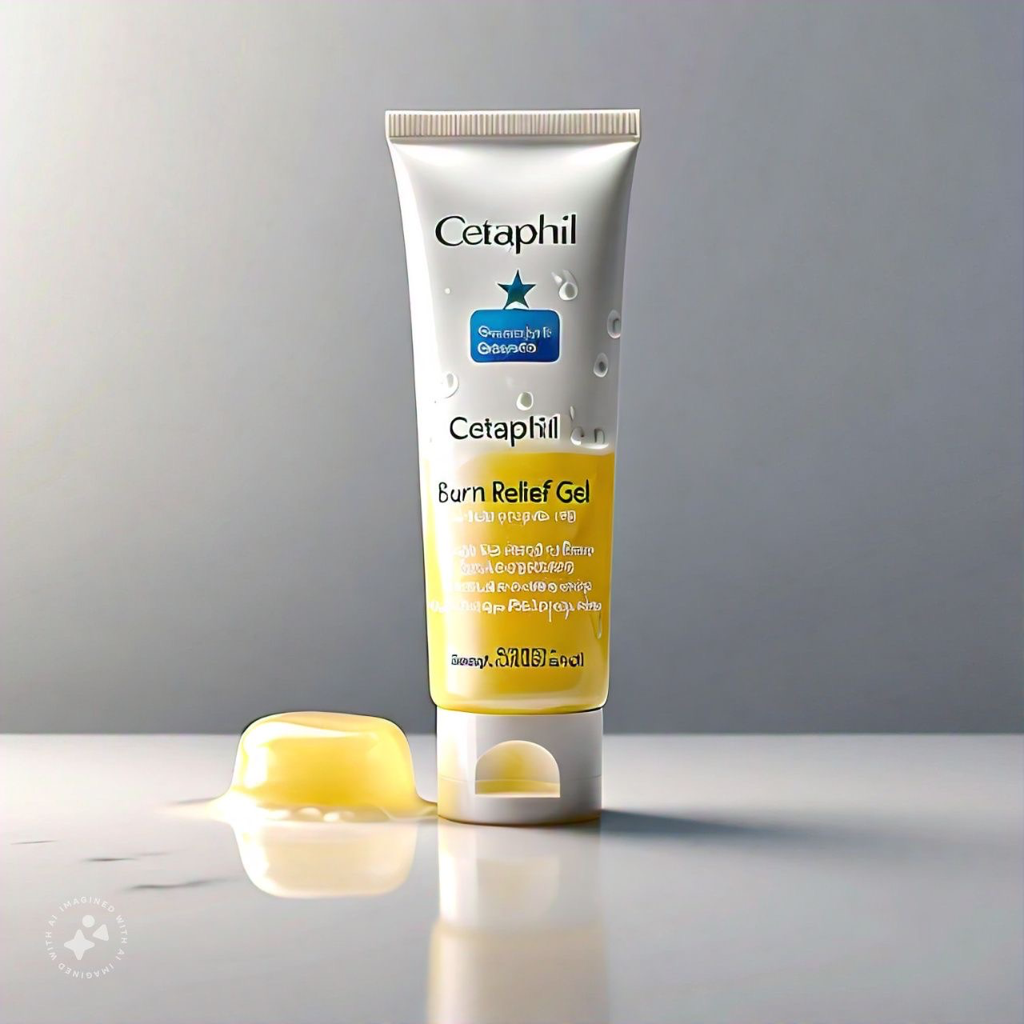

Leverage wound care growth by targeting collagen, hydrogel products, and addressing consumer needs for faster healing
Scar treatment Product Range – Teaser launch
Wound Care – A booming market
Scope for Cetaphil to Explore
Synergies with Cetaphil
Wound Care – Revenue Growth (Bn USD)
Growth Drivers
Brand Trust
Growing Geriatric Population
Regulatory Synergy
Derma Expertise
Demand for faster recovery
Increase in perceived image of beauty
Cross-selling
Strong Distribution
Advanced Wound Care - % Share
By Category
By Product Type
Strategy
Category | Share %
Surgical | 45%
Trauma | 35%
Infected | 20%
Target Customers – Primary Research
Product Portfolio
“These pregnancy stretch marks are such a pain to remove”
Scars & Marks Ointment
“How do I get rid of my ugly surgery scars?”
Antiseptic ease spray
“I need a way to quickly cover any scratches or wounds before my next hike”
Burn-relief gel
Growing preference for collagen & hydrogel wound-care products
Source: Worldwide Media forecasts, groupM, 2-Kantar eMarketPulse | Google Trends data, IN, Beauty & Fitness, 2015-2020 | Kantar Worldpanel, 2- Kantar e-Market Pulse 2019 | Understanding India’s online video viewer, Think with Google article

Slide 11
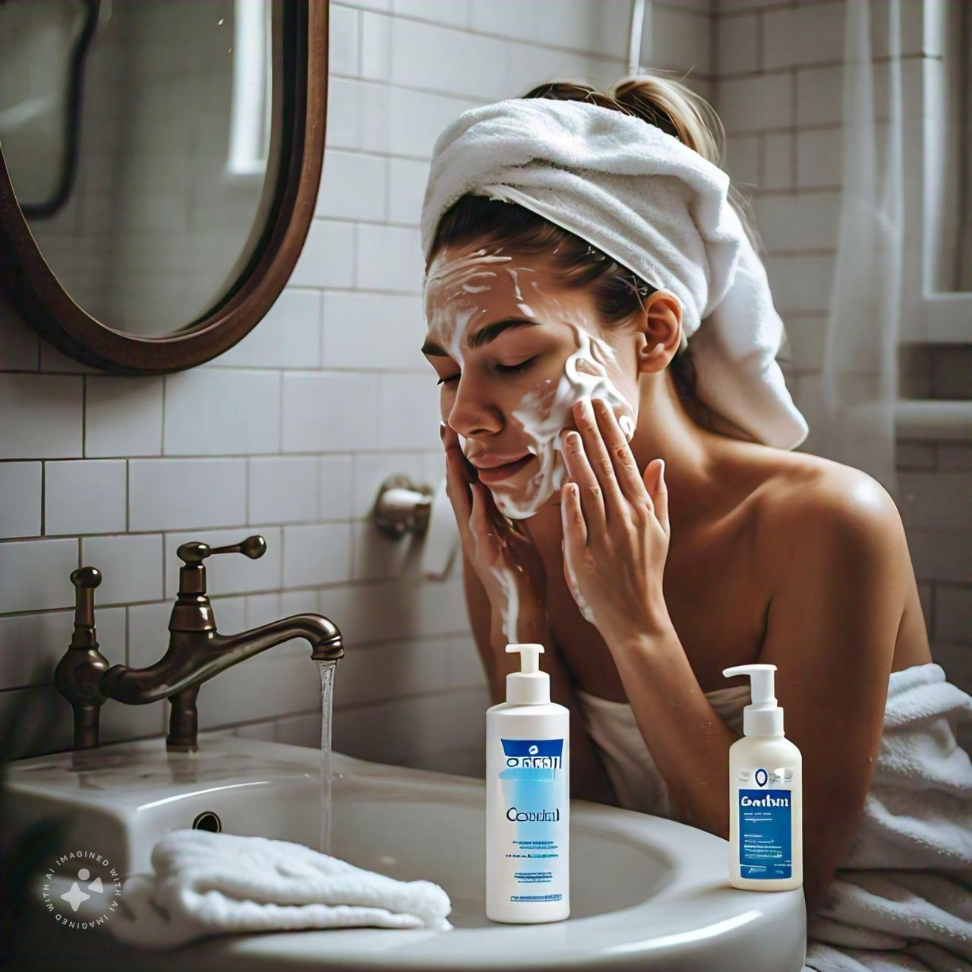
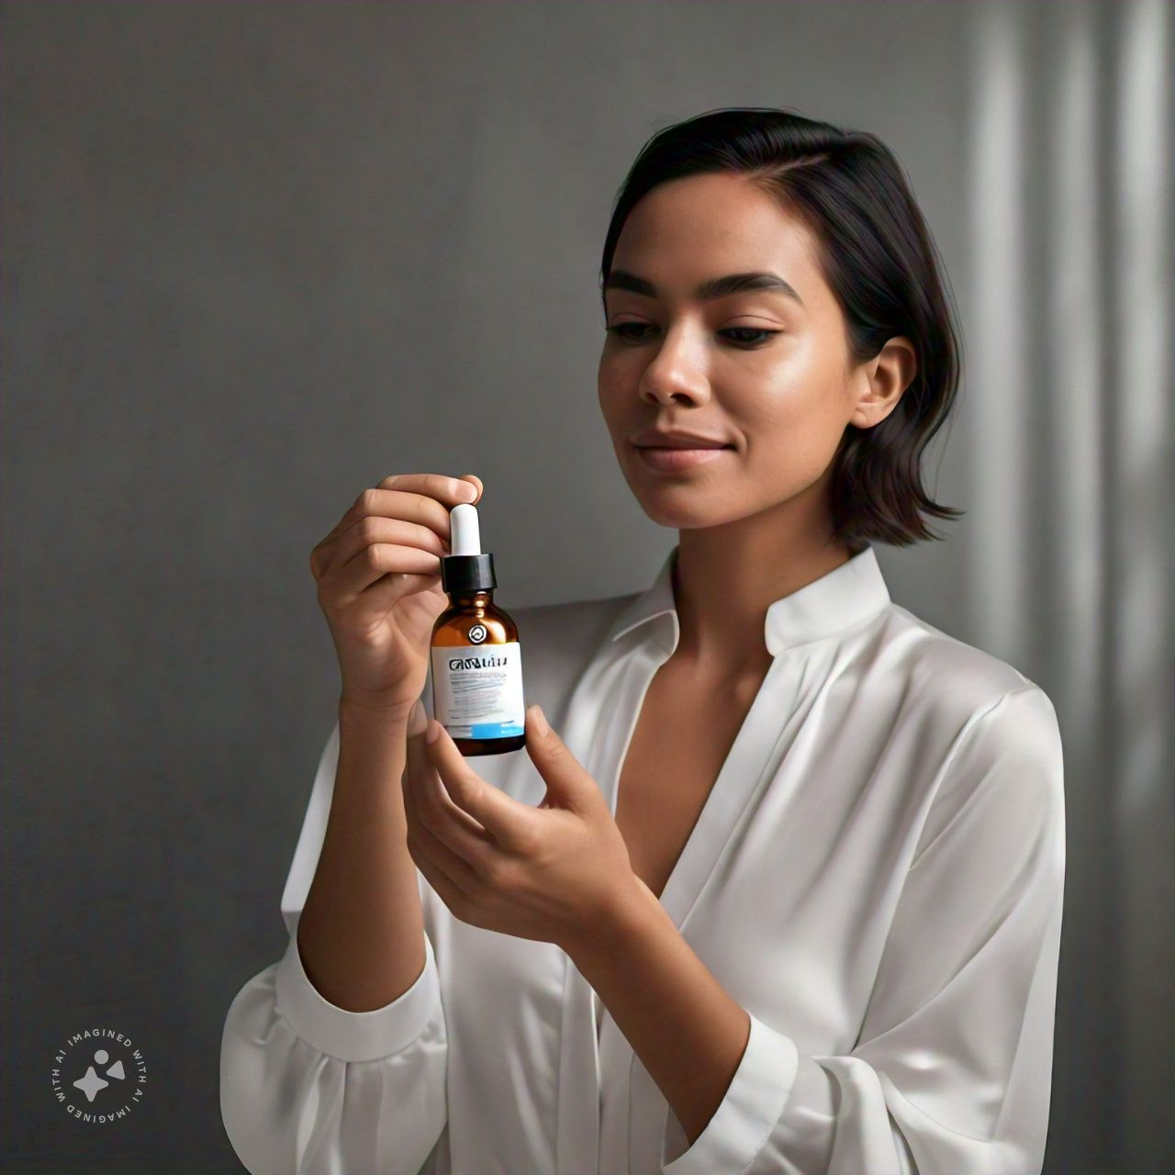
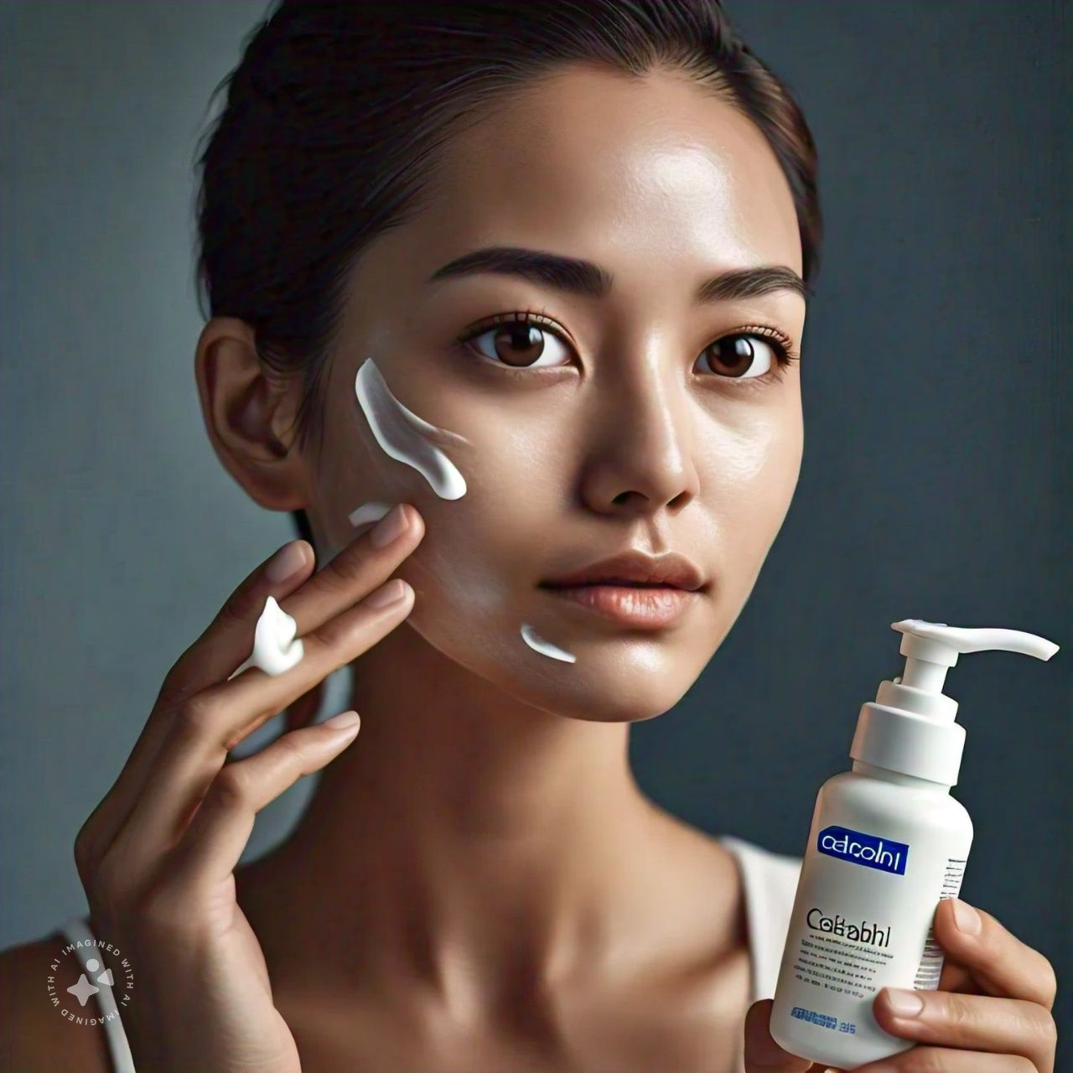
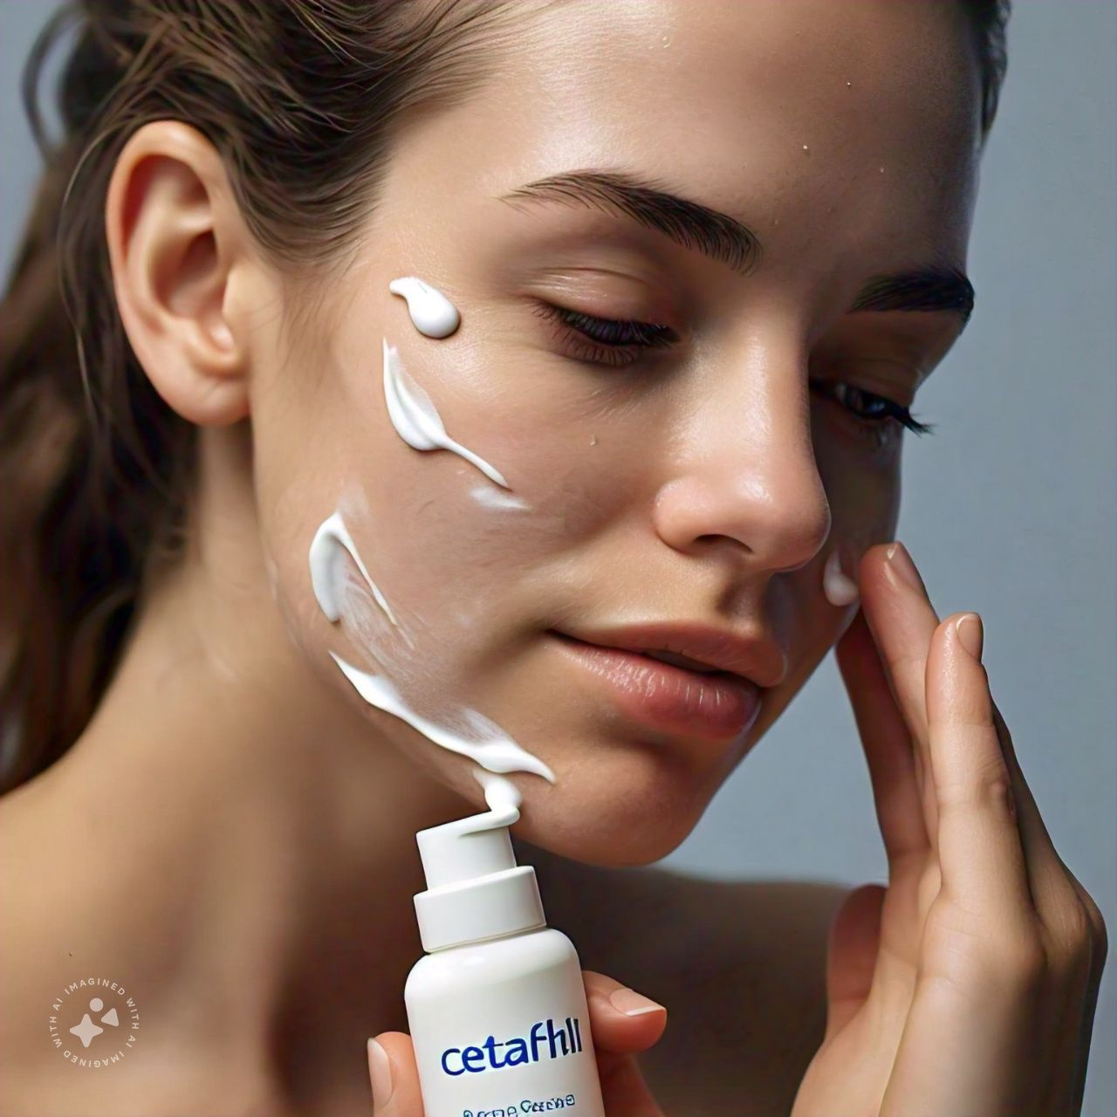
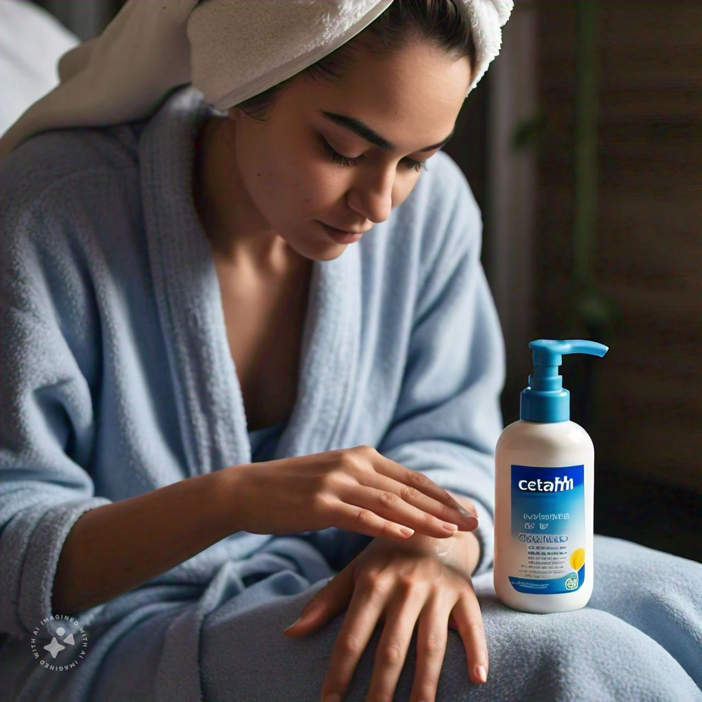
















Phase-wise expansion into men’s skincare with scalable strategies and global reach to enhance Cetaphil’s growth
Implementation Roadmap and Scalability
Awareness
Engagement
Loyalty & Retention
Rapid Expansion
New Product Launch
Week 1 – 2
Week 3 – 5
Week 6 – 8
Week 9 – 12
Months (4-8)
Streamline Cetaphil Cam & partner with key locations for presence
Onboard doctors to CetaCare platform
Drive referrals via social media & offer incentives
Launch trade promotions via website & popular merchants
Scale rapidly in Tier-1 & select Tier-2 cities
Conduct market research for wound-care product line
Identify target markets
Develop Cetaphil quiz; put up hoardings
Put up kiosks & kits
Prototype & pilot wound-care line to validate
Launch product line in target markets
Scalability
Expansion into Men’s Skincare
Possible Impact
Size in Bn USD
Competitors
Recent Trends
Personalized routines
2.1
4.1
Diverse skin demands
Expansion of customer base
Reinforcing brand positioning
Rapid global expansion
Specialized products

Slide 12
Thank You
Appendix

Slide 13



Appendix – Other brands creating a buzz
Vaseline emphasizing its Gluta-Hya line that promises visibly glowing skin from the first use, attracting shoppers in a retail setting.
Vending machines setup at Tira store providing samples of various trending brands like YVES perfumes but not any of the Cetaphil products.
Cetaphil was notably absent from the shelf, missing an opportunity to compete in-store alongside other skincare brands.

Slide 14




Appendix – In the offline consumer journey, online touch points continue to be critical for trends, comparison & usage
Today the beauty journey consists of highly connected, non-linear moments (VUCA to BANI)
Tier 1 is the standout, matching Metros step for step across different stages of the consumer journey
Consumers are highly engaged with content online
Search is the new Shopping Aisle driving discovery for products purchased online & offline

Slide 15


Appendix – Gender divide in beauty is a myth; Male consumers continue to showcase interest in Beauty categories online

Slide 16



Appendix – Online reviews on Reddit

Slide 17



Appendix – from Similarweb

Slide 18




Appendix – from Similarweb

Slide 19

Appendix – Media Recommendations

